Slide 1
Global networks for early phase trials: directions in HIV
Mark Polizzotto | NSW Drug Development Conference | 23 March 2017

Slide 2
Key Characteristics of HIV Research

Slide 3
Challenges in Improving HIV outcomes
1. Better HIV therapies and better access to therapy still needed
Particular issue in LMICs where burden of disease is greatest
Post first line therapy still complex and poorly defined
D²EFT: Dolutegravir and Darunavir Evaluation in Adults Failing Therapy
2. Persistent inflammation in HIV infection is associated with worse clinical outcomes
Elevated risk particularly of cardiovascular disease but also other comorbidities and death in patients with ongoing inflammation
ADVICE: Attenuation of D-dimer using Vorapaxar to target Inflammatory and Coagulation Endpoints
3. Elevated risk of malignancy remains a defining feature of HIV infection
Despite this persistent elevated risk, access to new and emerging cancer therapies very limited and routine exclusion from clinical trials
National Cancer Institute AIDS Malignancy Consortium
Polizzotto, Mitsuyasu Curr Opinion HIV 2016

Slide 4
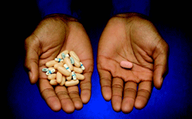
1: Optimising Second Line ART
ART provided in low and middle income countries (LMIC) through donor agency programs
Programs delivered care to 13 million people by 2015; projected to increase to 30 million by 2020
Standardised treatment regimens using coformulated drugs
First line therapy failure rate 15% per annum
Failure results in switching to a more expensive second-line ARV regimen (US$465 py versus US$146 py)
Simple and sustainable approach needed for second-line therapy.

Slide 5
Ideal Second Line ART
Criteria for ideal second-line cART regimen in resource limited settings:
Primary Criteria
high potency
high genetic barriers to resistance
established safety profiles
good tolerance
Secondary criteria
able to be administered once-daily
no impact on the activities of daily living
able to be co-formulated
SECOND-LINE study
NRTI-sparing strategy
Dual combination (PI and II) vs standard triple therapy with NRTIs
Better safety and tolerability was observed for the experimental dual regimen
Emery, Cooper Lancet 2014

Slide 6
D²EFT Study Design
Multinational, multicentre, randomised, open-label study in HIV infected patients who have failed their first-line ARV regimen
Non-inferiority design based on 12% delta
3
Randomisation 1:1
N=610
SOC regimen (DRV/r + 2N(t)RTIs)
DTG regimen (DTG + DRV/r)
45 day screening
Week 0
Week 48
Week 96
1
2
4
Failed first-line NNRTI + 2N(t)RTI combination therapy (HIV RNA >500 copies/mL after ≥24 weeks continuous first-line therapy)
No prior exposure to PIs or INSTIs
All eligibility criteria met
Primary endpoint (week 48)
Proportion with pVL <50 copies/mL
Safety endpoints

Slide 7
D²EFT Study Sites
610 participants from approximately 25 centres across 10 countries in Latin America, Southern Africa and Asia
Two industry partners (Janssen and Viiv)

Slide 8
D²EFT Summary
Urgent unmet need for a simple regimen of second-line cART for use in resource-limited settings
Realistic opportunity for co-formulation into a one pill, once daily tablet potentially without the need for HIV drug resistance testing.
These characteristics would permit a public health approach (red pill/blue pill) to the management of HIV disease in resource-limited settings.
If non-inferiority established, potential rapid translation of findings into the treatment of millions of people in resource-limited settings.
At a time of flat line funding to donor agencies this is a critical initiative that will allow ambitious treatment objectives to be realised

Slide 9
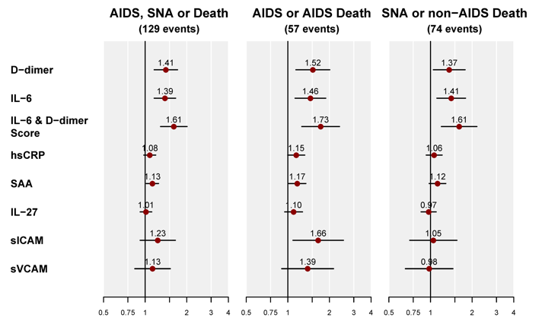
2: Addressing Persistent Inflammation
Persistent inflammation in HIV infection is associated with worse clinical outcomes
Baker, CROI 2017

Slide 10
PAR-1 and Persistent HIV-associated Inflammation
Persistent inflammation in HIV infection is associated with worse clinical outcomes including mortality
Thrombin induces inflammation by signalling via PAR-1 on cells such as monocytes, dendritic cells, and T cells
People with HIV show increased circulating platelets, platelet microparticles and monocyte-platelet complexes
Tissue injury in the context of HIV replication may promote thrombin formation and PAR-1 dependent signalling that in turn supports immune activation and inflammation
Can a PAR-1 antagonist reduce biomarkers associated with poor clinical outcome in people with HIV?
Kuller, PLOS Medicine 2008

Slide 11
Vorapaxar and PAR-1
Persistent inflammation in HIV infection is associated with worse clinical outcomes including mortality
Vorapaxar (Zontivity) is an oral competitive PAR-1 antagonist that inhibits thrombin-induced platelet aggregation
No effect on P-selectin or CD40L, bleeding time or coagulation factors (PT, aPTT, ACT, ECT, TT)
Licenced in USA for secondary prophylaxis in people with history of CVS
TGA licencing application underway
>80% inhibition of platelet aggregation within 1 week (in vitro)
Inhibition of platelet aggregation at a level of 50% can be expected at 4 weeks after stopping vorapaxar

Slide 12
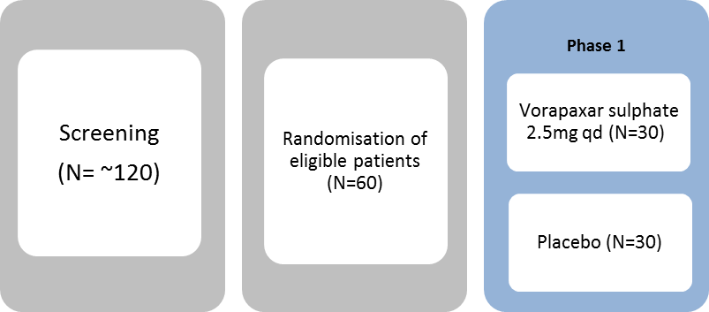
ADVICE Study Design
Multicentre Randomised Phase II study of vorapaxar in patients with persistent HIV-associated inflammation despite ART Patients with well controlled HIV disease • Treated with an ART regimen that contains NRTIs in combination with either raltegravir or dolutegravir • Selected for high D-dimer Primary endpoint differences between treatment groups in mean change from baseline D-dimer at weeks 8 and week 12
• Secondary endpoints include virological and inflammatory markers and safety
No study drug given
-2 weeks day 0 weeks 1 4 8 12 18

Slide 13
ADVICE Study Sites
60 participants from approximately 10 centres across Australia and the United States

Slide 14
3. Addressing HIV-associated Malignancies
Elevated risk of malignancy remains a defining feature of HIV infection
Epidemiology of HIV-associated malignancies is evolving
Malignancies less associated with severe immunosuppression (non-AIDS-defining malignancies) now equally important
Better HIV control and supportive care provide platform for delivery of standard treatments for most malignancies
Better therapies and better access to therapy still needed
Screening, treatment and outcome disparities persist despite advances in HIV and cancer therapeutics
Access to emerging and investigational studies very limited despite disproportionate burden of disease
Multi-disciplinary care models are not well developed
Dedicated treatment planning including HIV, haematology/oncology, and allied health required throughout clinical cycle
Polizzotto, Mitsuyasu Curr Opinion HIV 2016

Slide 15
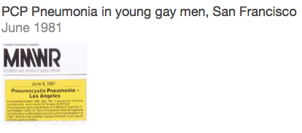
Immunity and viral malignancies
Kaposi Sarcoma Incidence
Source: New York State Cancer Registry

Slide 16
Malignancies in People with HIV
Malignancy | Incidence (per 100,000 PY) | Standardised Incidence Ratio | Proportion Occurring in People with HIV/AIDS
All Cancer Types | 468 | 2.1 (2.0-2.3)
AIDS Defining Cancers
Kaposi sarcoma | 173 | 1300 (1100–1500) | 81.6% (81.2%-81.9%)
Diffuse large B-cell lymphoma | 50 | 9.6 (7.7–12) | 6.0% (5.8%-6.1%)
Burkitt lymphoma | 7 | 15 (7.9-27) | 19.9% (18.1%-21.7%)
Primary CNS lymphoma | 15 | 250 (160–360) | 27.1% (26.1%-28.1%
Invasive cervical cancer | 44 | 2.9 (1.9-42) | 0.42% (0.37%-0.47%
Non-AIDS Defining Cancers
Anogenital | 10 | 9.2 (5.5–15) | —
Hodgkin Lymphoma | 19 | 5.6 (3.9–7.8) | —
Head and Neck | 14 | 1.7 (1.1–2.5) | —
Hepatocellular | 8 | 2.7 (1.5–4.6) | —
Lung Cancer | 59 | 2.6 (2.1–3.1) | —
Pancreas | 8 | 2.2 (1.2–3.6) | —
Parkin, Int J Cancer 118: 3030–3044 (2006). Shield M, JAMA 305:1450-9 (2011)

Slide 17
HIV and Cancer in Australia
30000 people living with HIV 1200 new HIV cases annually (stable) World recognised care implementation Aging HIV-infected population >200 new cancers in people with HIV annually
Kirby Institute Annual Surveillance Report (2015) Petoumenos, K. et al., HIV Medicine (2013), 14, 77-84

Slide 18
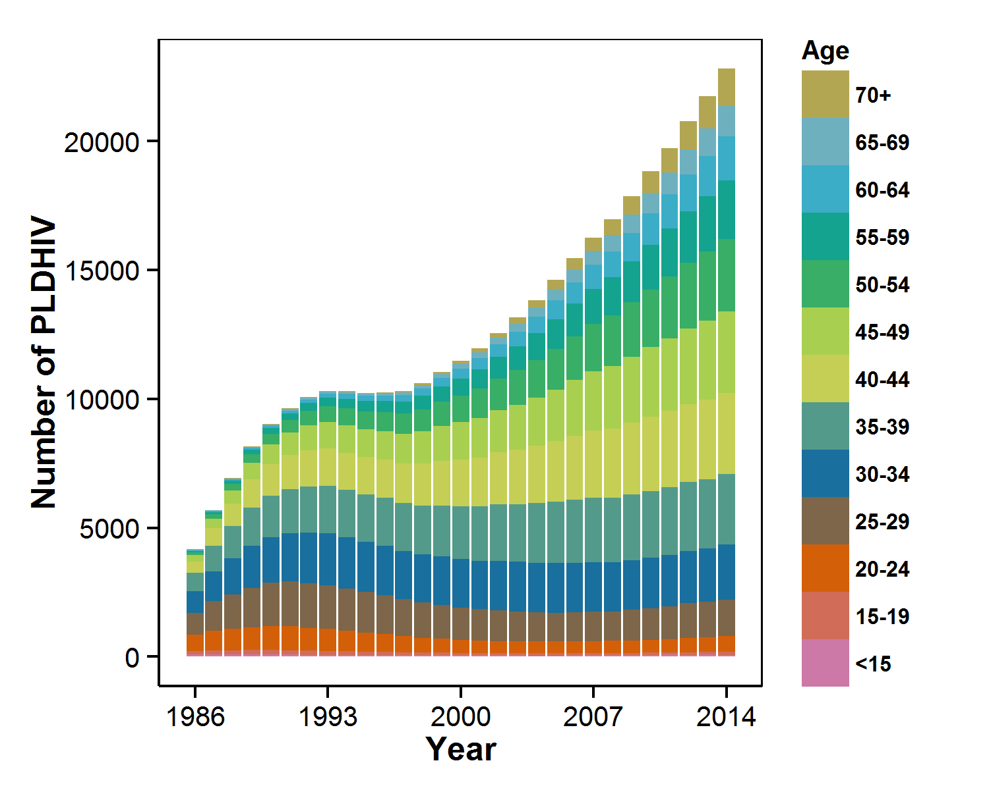
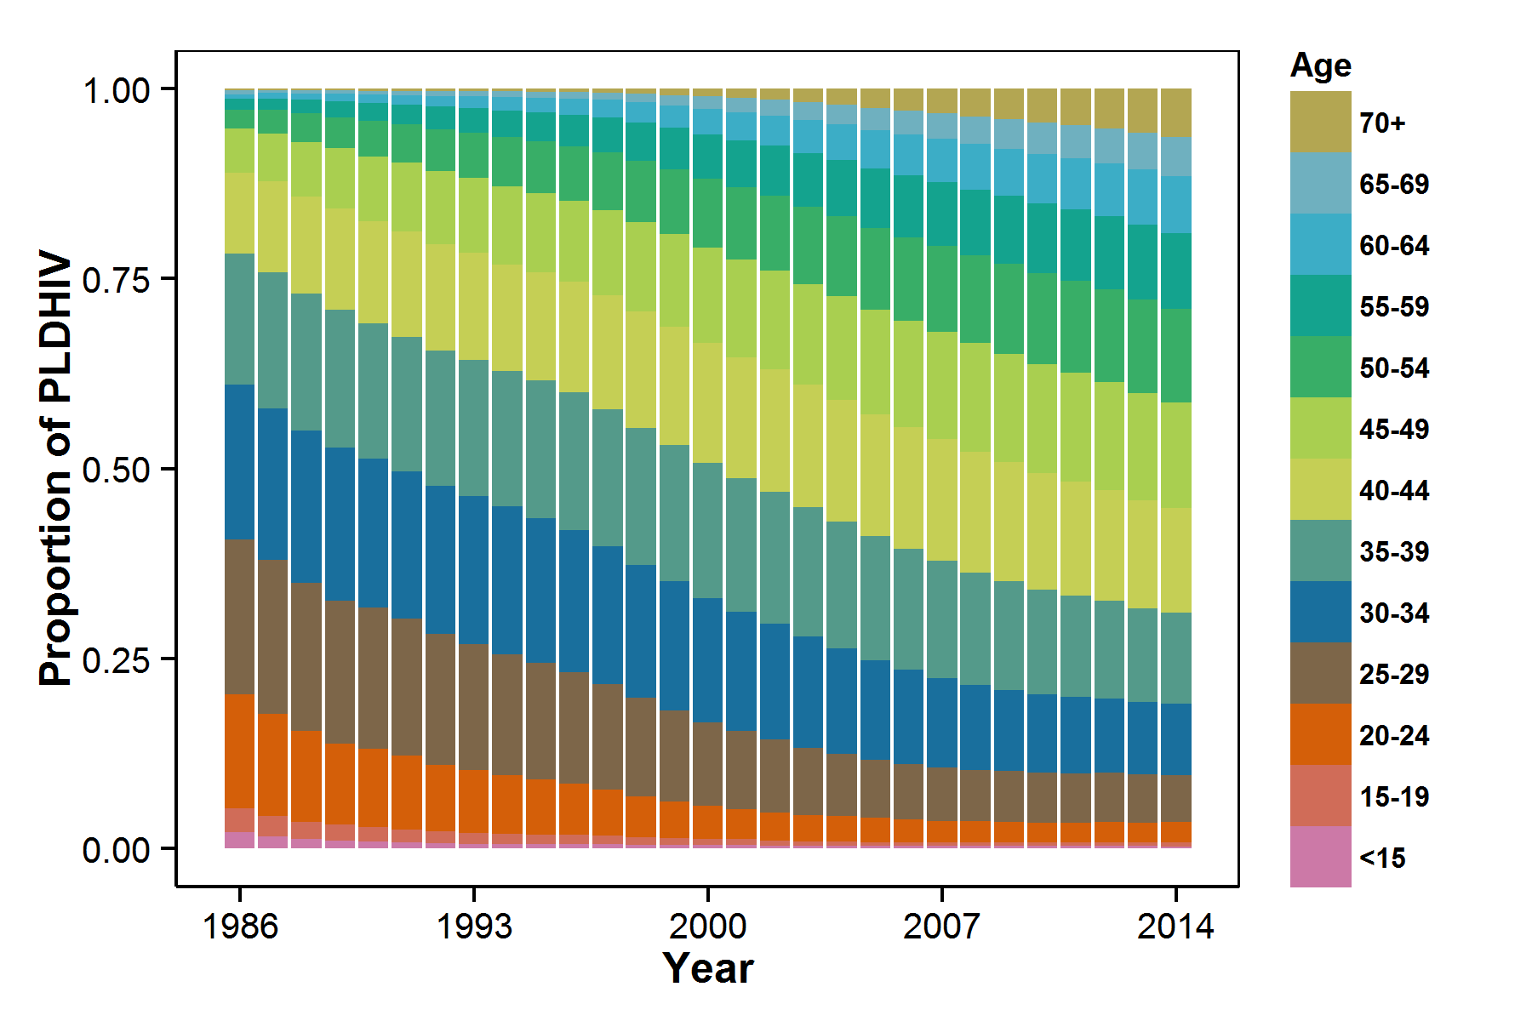
Ageing of People living with HIV/AIDS
>50% of cancers occur in people >60 years
Courtesy Richard Gray, Kirby Institute (Unpublished Data)

Slide 19
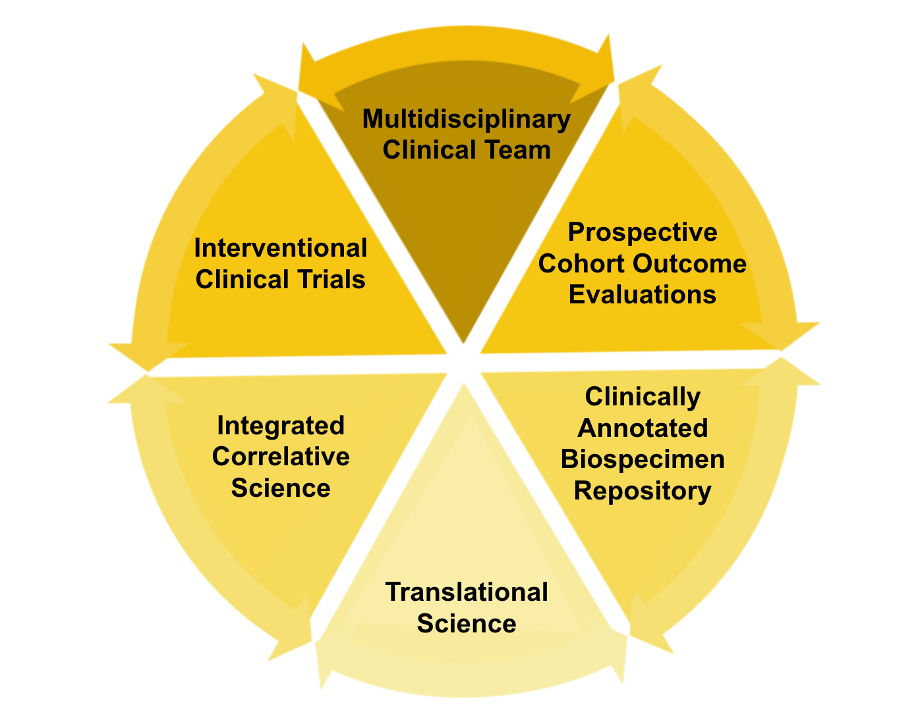
HIV Malignancy Studies

Slide 20
AIDS Malignancy Consortium

Slide 21
AIDS Malignancy Consortium
AMC sites as at 2015-2023 consortium renewal

Slide 22
HIV Malignancy Trial Portfolio
First Line
Post First Line
Non-Hodgkin Lymphoma
Ibrutinib + Rituxumab + daEPOCH
Ibrutinib+ ICE
AlloSCT
Hodgkin Lymphoma
Brentuximab Vedotin+ AVD
Kaposi Sarcoma
sEphB4-HSA
Pomalidomide
Nelfinavir
Solid Tumours Including HPV
Cabozantinib
Ipilimumab + Nivolumab

Slide 23
Checkpoint Blockade with Ipilimumab and Nivolumab
AMC-095
Disease: Metastatic or unresectable tumours or uncontrolled KS
Context: Post First Line
Phase: I (dose and agent escalation) II (dose expansion)
Regimen: Nivolumab ± Ipilimumab followed by Nivolumab maintenance
ART: Standard
CD4: Sequential strata (≥200, ≥100)

Slide 24
Selective Cytotoxicity with Brentuximab
AMC-085
Disease: Hodgkin Lymphoma
Stage: II-IV
Context: First Line
Phase: I (de-escalation) II (dose expansion)
Regimen: Brentuximab added to AVD backbone
ART: No CYP3 inhibitors
CD4: No threshold

Slide 25
4. Intersection of Infectious Diseases and Cancer
Burden of Disease
World Health Organisation estimates:
18% of cancer cases are caused by infection
12% are caused by one of seven human tumour viruses
Hepatitis B and C (4.9%)
Human T-cell Lymphotrophic Virus (0.3%)
Merkel Cell Polyomavirus (<0.1%)
Epstein Barr Virus (1.0%)
Kaposi Sarcoma Herpesvirus (0.9%)
Human Papillomavirus (5.2%)
WHO IARC

Slide 26
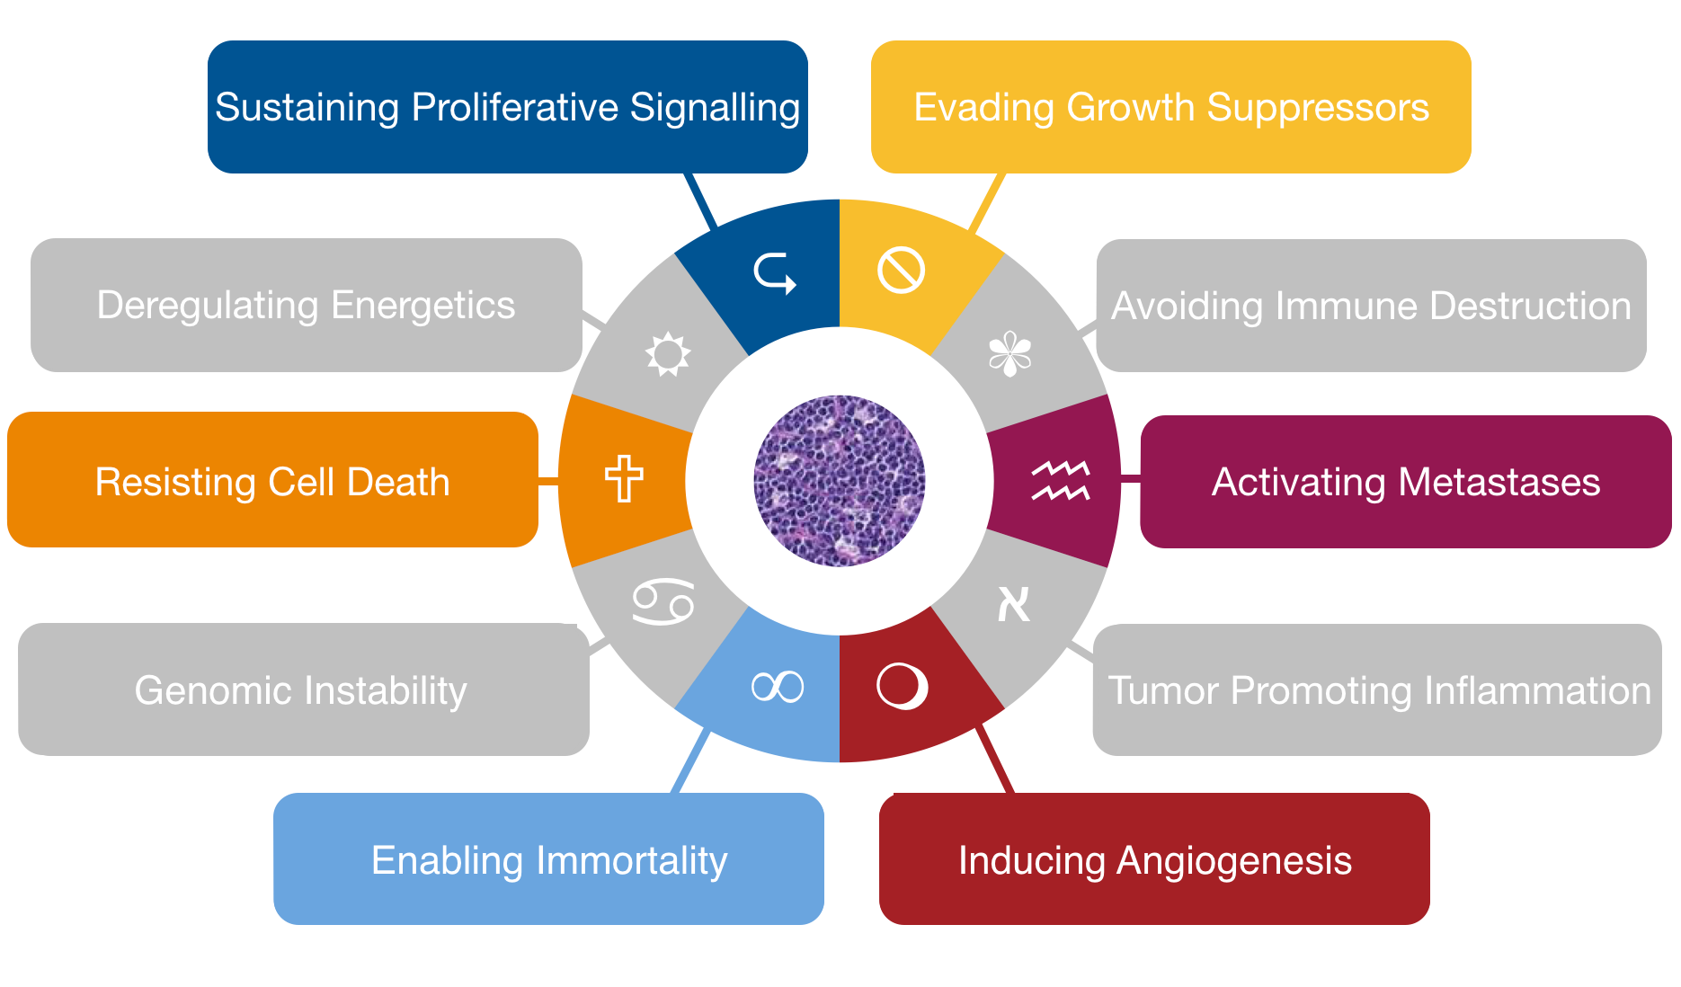
Infectious Agents and the Hallmarks of Cancer
Adapted from Hanahan and Weinberg, Cell 2000 and Cell 2011; Mesri, Cell Host Microbe 2014

Slide 27
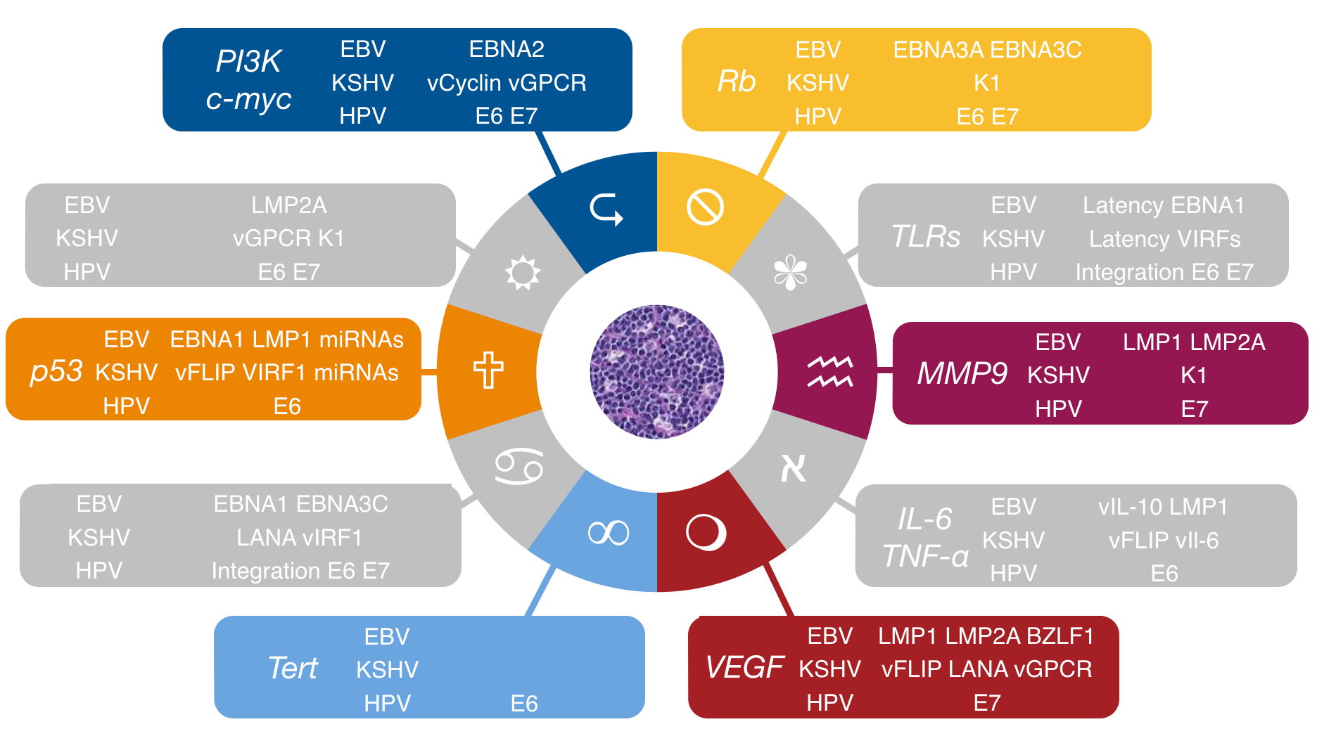
Infectious Agents and the Hallmarks of Cancer
Adapted from Hanahan and Weinberg, Cell 2000 and Cell 2011; Mesri, Cell Host Microbe 2014

Slide 28
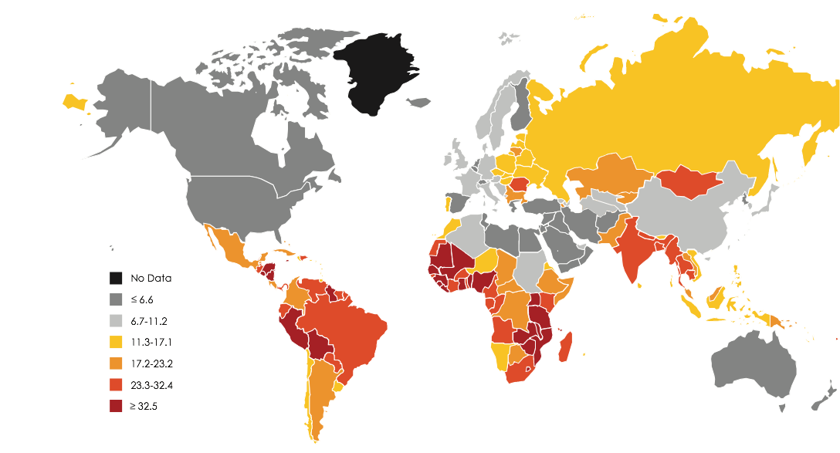
Infection and the Global Burden of Cancer
HPV-Associated Cancer Incidence
Around 18% of all cancers worldwide Over 35% of cancers in many resource-limited settings
Adapted from GLOBOCAN 2013

Slide 29
Summary Points
Rapid progress in HIV therapies has been facilitated in large part by the early development of extensive global trial networks
Continuing challenge to optimising outcomes for people living with HIV
Optimising antiretroviral therapy
Prevention of complications, especially cardiovascular and malignant
Therapy of malignancies
Australian sites have played a leading role in this process, leading and participating in major networks in each area
HIV trial networks have proved adaptable to these evolving challenges
Continuing demonstration that LMIC sites can deliver high quality research even in early stage
For high risk and high complexity therapies including cancer, development in high income settings followed by diffusion to LMICs
Emerging needs, including cancers related to infection, may also be met by continued adaptation of HIV trial networks

Slide 30
Acknowledgments
Patients and their families
St Vincent’s Hospital David Cooper Sean Emery Sam Milliken Tony Kelleher Philip Cunningham Anthony Joshua Terry Campbell Trish Chronopoulos
Kirby Institute Anna Donaldson Sally Hough Griselda Buckland Daniel Murray Carmella Law Simone Jacoby David Silk
Celgene Corporation Jerry Zeldis Dirk Hoenemann Evelien Rosens
U.S. National Cancer Institute Robert Yarchoan Mustafa Nokta Rebecca Huppi Silvia Silver
U.S. National Institute of Allergy and Infectious Diseases Irini Sereti Cliff Lane

Slide 31
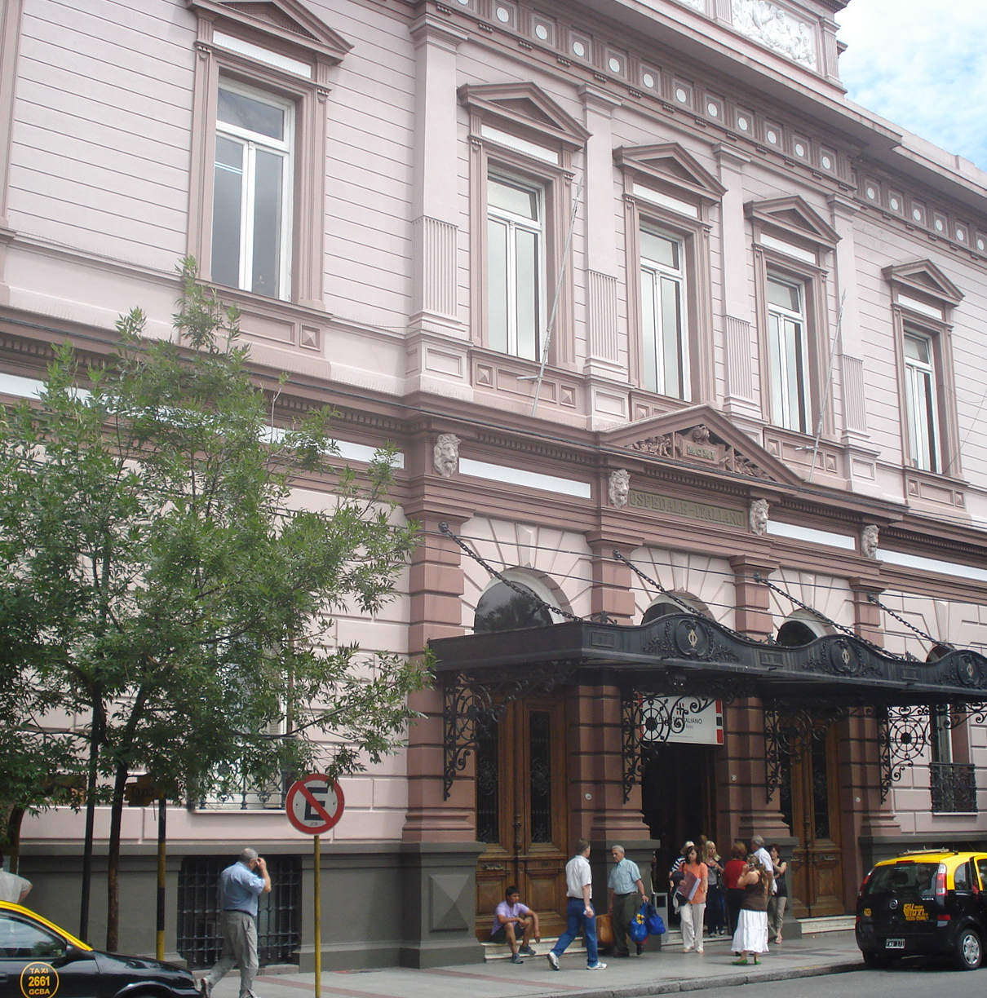
Subject 1 (Classical KS)
Week 20

