Slide 1




Integrating research into
Early phase trials in Melanoma
A/Prof Alex Menzies
Melanoma Institute Australia
Royal North Shore Hospital
The University of Sydney

Slide 2
Research on early phase trials – WHY?
Value add
Tremendous opportunity for academic clinicians/ scientists
Sets up the institute as a world leader
Ensures access to the best trials, at the earliest opportunity
Spin offs into investigator-led studies
Patients love it!

Slide 3
Research on early phase trials – HOW?
Good staff
Detailed clinical database
Biospecimen collection program and database
Good trials

Slide 4
Research on early phase trials – HOW?
Good staff
  Need people who will go beyond the norm
  Multidisciplinary network –esp surgery, pathology, scientists & academic med oncs
Detailed clinical database
  All patients, detailed annotation, up-to-date
  Broad data – efficacy, toxicity, prior/later therapies, lesional response
Biospecimen collection program and database
  All patients, archival and new
  Tumour (FFPE, fresh), blood, stool, toxicity biopsies
Good trials
  Pick the best, recruit well
  Pan-tumour vs specific
When something looks good - strike when the iron is hot!

Slide 5
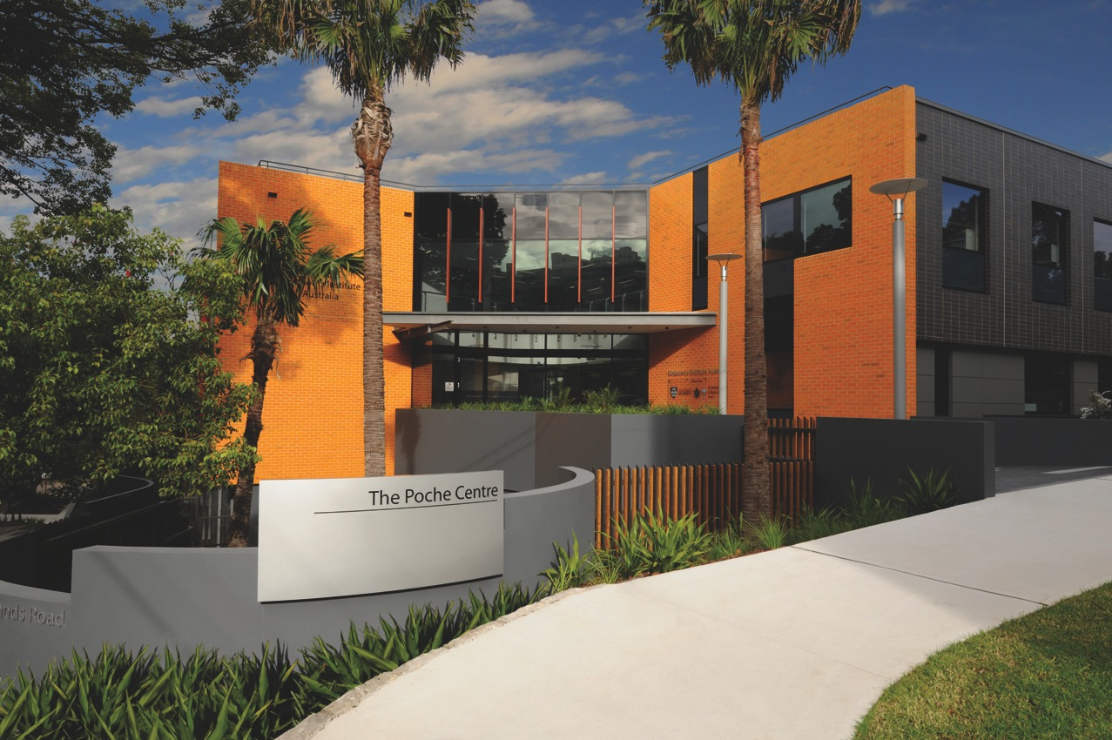
Melanoma Institute Australia
Mater Hospital
Royal North Shore Hospital
Westmead Hospital
Royal Prince Alfred Hospital
USYD
Macquarie Uni

Slide 6

Overall Survival: Metastatic Melanoma
Phase III Studies
Ipilimumab
Ipilimumabª
Vemurafenib
Dabrafenib
Nivolumab^{b}
1-year OS
71%¹⁰ Pembrolizumab^{c}
74%¹¹ Dab + tram^{d}
75%¹² Vem + cobi
25–35%¹
46%²
47%⁴
56%⁶
70%⁷
71%⁸
73%¹³ Nivo + ipi
1990
2010
2011
2012
2013
2014
2015
2016
2017
15%¹
24%²
29%⁴ Ipi ª
30%⁶
45%⁷
58% Nivo⁸
53%¹¹ Dab + tram
64%¹³ Nivo + ipi
2-year OS
48%¹² Vem + cobi
55%¹⁴ Pembrolizumab
3-year OS
58%¹⁹ Nivo + ipi
22%³
24%¹⁷
44%¹⁵ Dab + tram
37%¹⁶ Vem + cobi
52%¹⁹ Nivo
5-year OS
18%⁵ Ipiª
35%⁹ Nivo (ph I)
28%¹⁸ Dab + tram (ph 2)
a. Ipilimumab + DTIC; b. BRAF WT only; c. Pooled pembrolizumab Q2W and Q3W 10mg/kg; d. Pooled dabrafenib + trametinib data.
1. M. Middleton Ann Oncol 2007;18:1691. 2. Hodi FS et al NEJM 2010;363:711. 3. Schadendorf D et al JCO 2015:33:1889. 4. Robert C et al NEJM 2011;364:2517. 5. Maio M et al. JCO 2015; 33:1191. 6. Chapman PB et al Poster presentation SMR 2015. 7. Hauschild A et al ESMO 2014. Abstract 1092. 8. Atkinson V et al SMR 2015. 9. Hodi FS et al AACR 2016. Abstract CT001. 10. Carlino M et al AACR 2016. Abstract CT004. 11. Long GV Lancet Oncol 2016. 12. Ascierto PA et al Lancet Oncol 2016:17:1248. 13. Larkin J et al AACR 2017:1558. 14. Schachter J et al ASCO 2016. Abstract 9504. 15. Flaherty K et al Oral presentation ASCO 2016. Abstract 9502.16. MacArthur GA et al. SMR 2016: 17. Chapman et al ASCO 2017. 18. Long GV et al ASCO 2017. 19. Wolchok et al NEJM 2017.
Presented by Georgina V Long, MIA

Slide 7

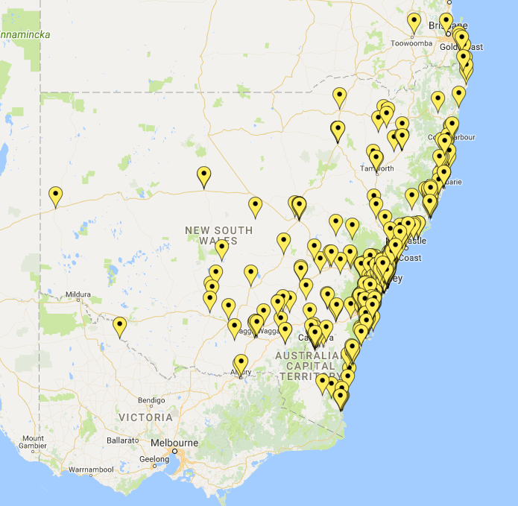
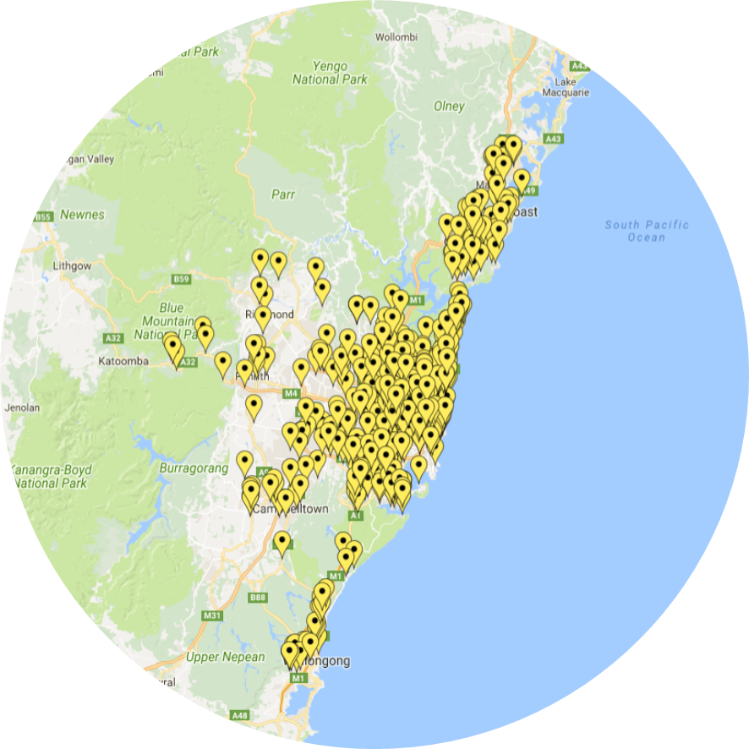

Melanoma Institute Australia
2014-2017
263 pts on systemic trials
68% of eligible pts on trials
Interstate
Sydney area
NSW

Slide 8
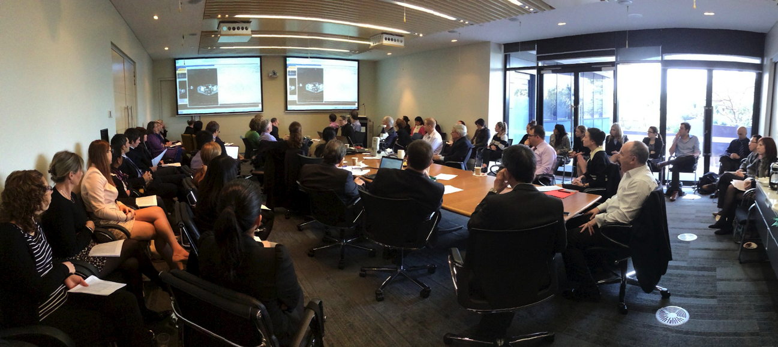
Where it all beings (and ends)….. the MDT

Slide 9
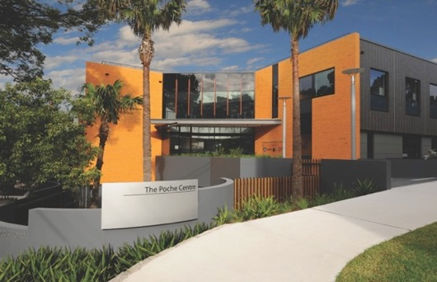
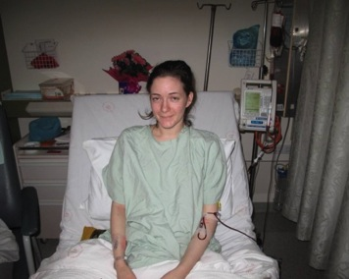
Biospecimen Bank
Research Database
 | Av p.a. | Overall
Blood Banked | 1405 | 15080
Metastases Banked | 402 | 6317
Primaries Banked | 101 | 1103
The Clinic
40 000 pt records
Clinical Trials
new drugs
new technology
Laboratories
USYD/CPC
MQU
Georgina V Long, MIA

Slide 10
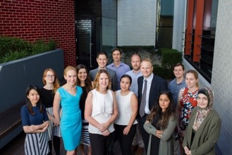


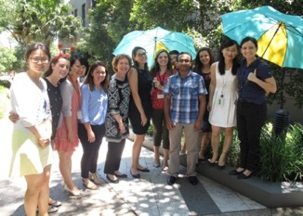

The Team
Biospecimen bank
& Lab Staff
Clinical Trials
Academic Clinicians

Slide 11
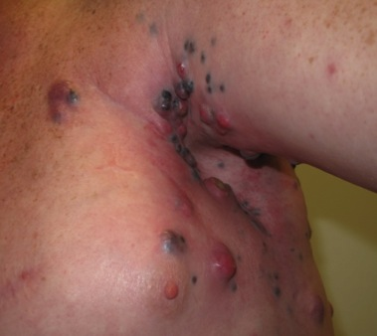

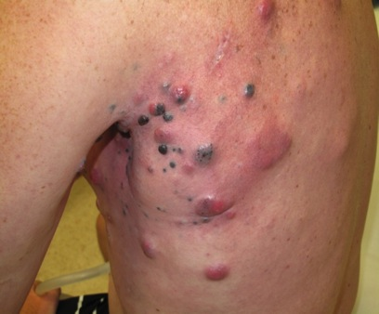
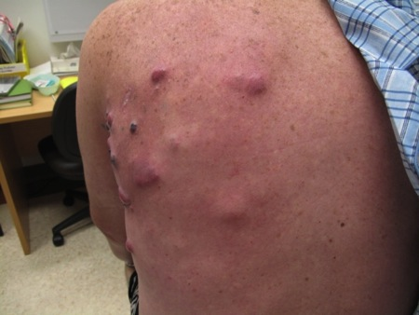
Translational Platform
Biopsy BEFORE
(-7 days)
Treat with novel drug
Biopsy Early During
Treatment (7days)
Biopsy PROGRESSION
PRE
EDT
PROG
PLUS blood, stool
Georgina V Long, MIA

Slide 12
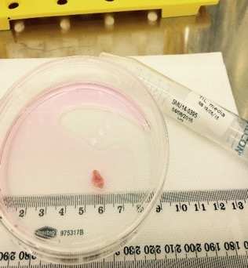
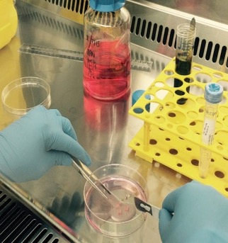
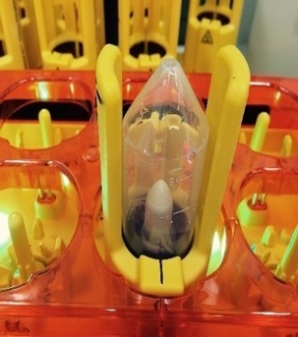
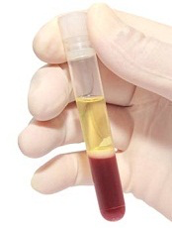
Translational biopsy platform – lab studies
STOOL
Tumour
Blood
HLA typing
IHC
WGS
RNAseq
Proteomics
Cytokines
TILs
Cytokines
ctDNA
Immunophenotype
(PBMCs, TILs, tumour)
Melanoma &
Tumour-associated fibroblast cell lines
Scolyer-Long-Rizos Lab

Slide 13
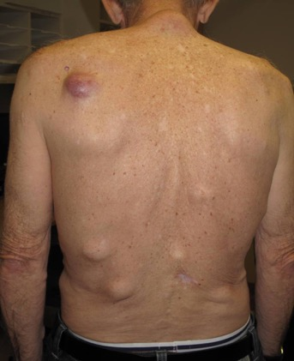
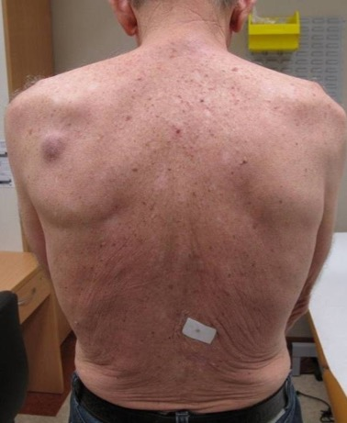
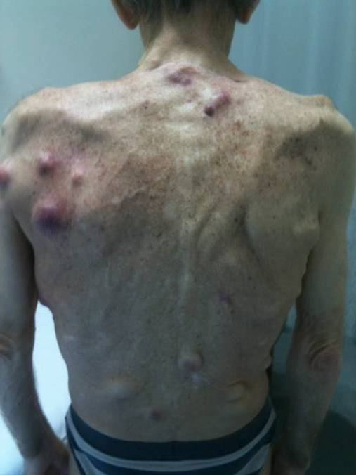
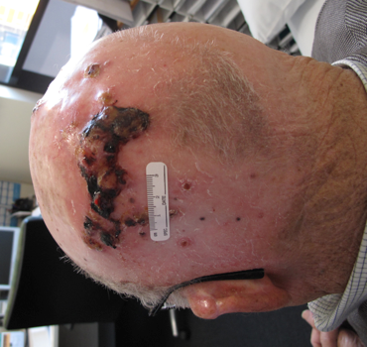
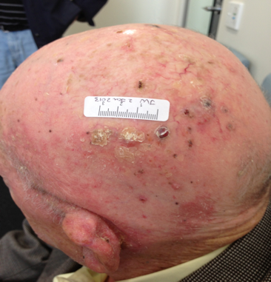
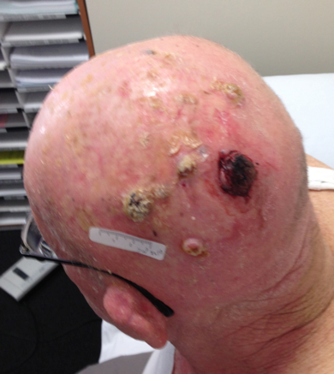
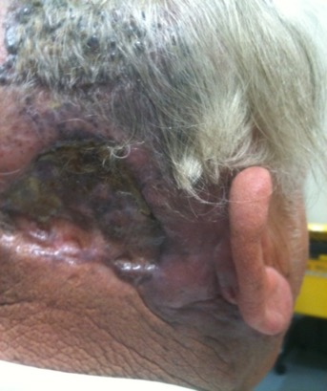
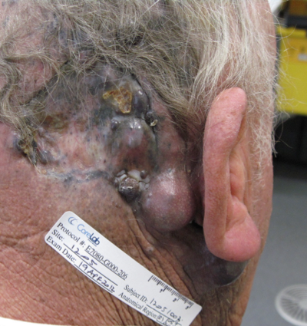
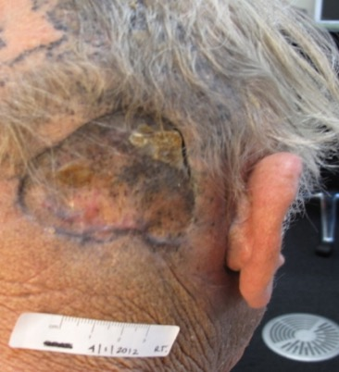
Baseline
Georgina V Long, MIA

Slide 14
Major MIA early phase trials
Dabrafenib phase 1
  50+ patients enrolled in 6 months
  Brain met expansion cohort
Dabrafenib + trametinib phase 1
  30+ patients enrolled in 6 months
Pembrolizumab phase 1
  50+ patients
Neoadjuvant, brain metastasis, intralesional, PD-1 failures….

Slide 15
V600K BRAF mutations
D594N
K601E
T599dup
V600E & L597V
V600E & V600K
V600E & K601E
V600R
V600_K601E

Slide 16
V600K BRAF mutations
D594N
K601E
T599dup
V600E & L597V
V600E & V600K
V600E & K601E
V600R
V600_K601E
80%
50%
25%

Slide 17
V600K BRAF mutations

Slide 18
V600K BRAF mutations

Slide 19
BRAFi for brain mets

Slide 20
BRAFi resistance

Slide 21
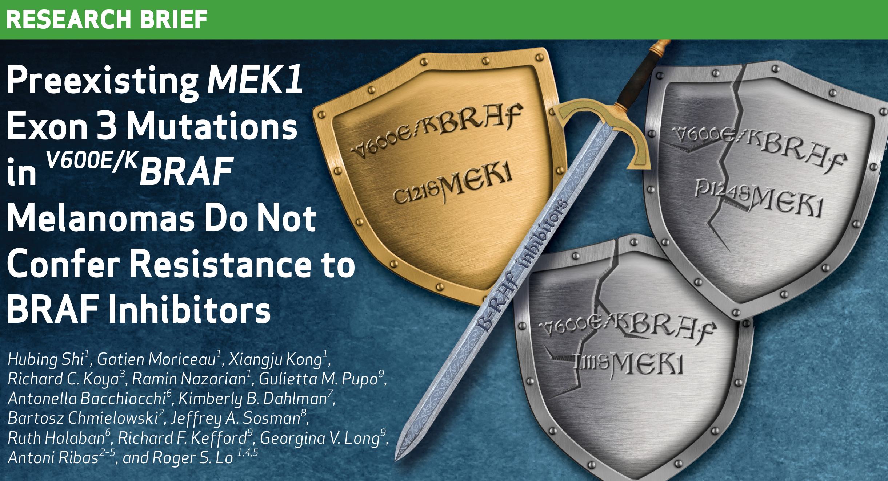
BRAFi resistance - collaborations

Slide 22
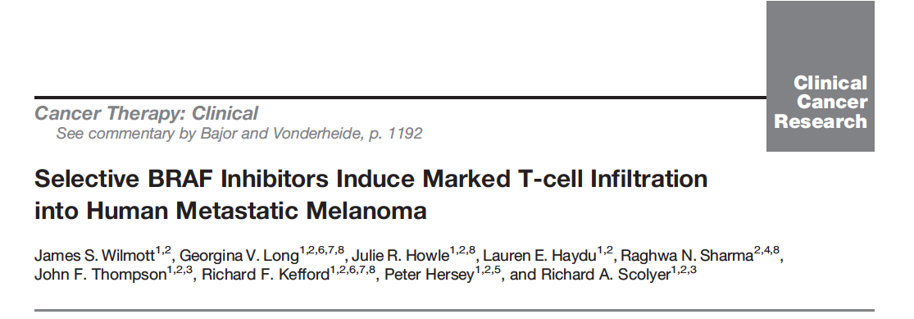
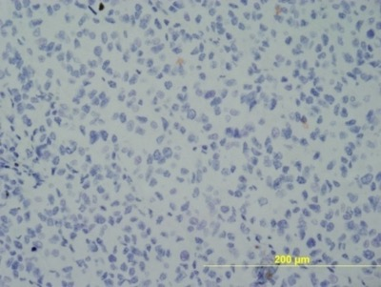
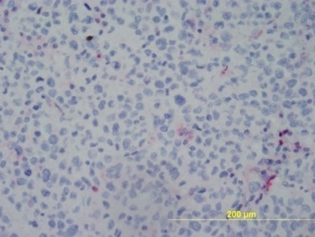
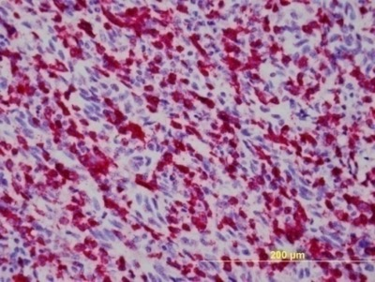
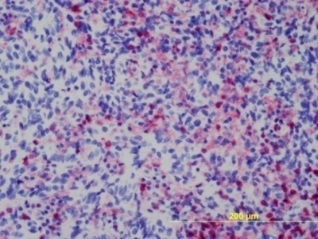
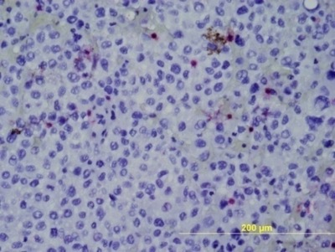
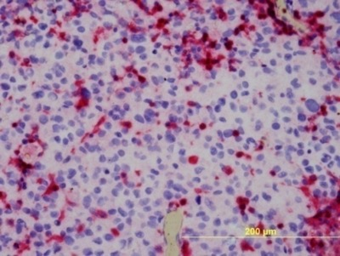
BRAFi and immune infiltrates
CD8
CD4
Baseline
Melanoma Ag ⬆
Responding
Day 7
Melanoma Ag ⬇
Progression
Notes:
Il-8 is immunossuppressive. High levels at baseline = poorer OS. It activated PI3 and MAPK.
IFN and CCL4 early in released from activated NK, later CD4&8 T cells.
APC release TNF
In turn, TNF and IFN allow the melanoma to evade immune system – TNF causes decreased melanoma Ag and increase IL-8 from melanoma cells, and IFN increases PDL1 on melanoma.

Slide 23
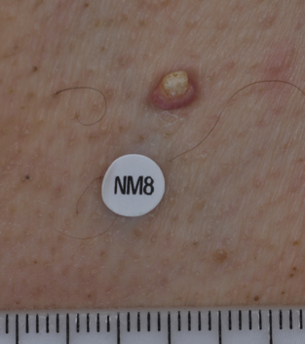
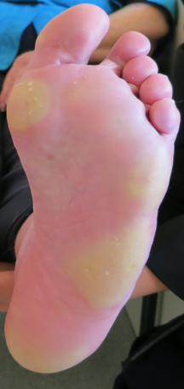
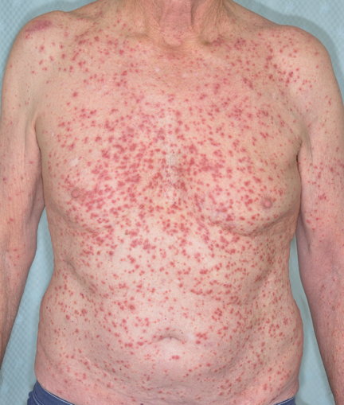
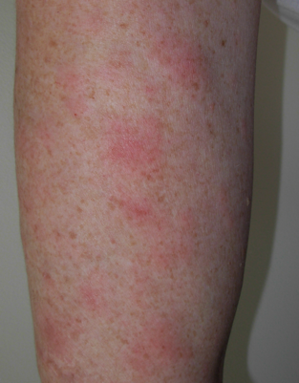
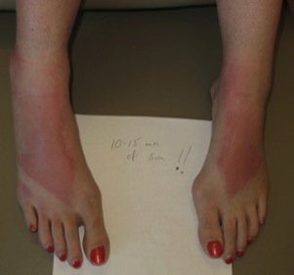
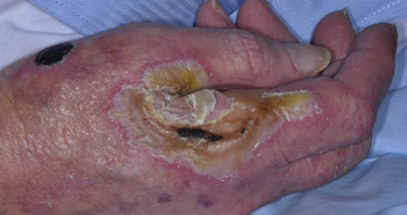
BRAFi toxicity

Slide 24
Immunotherapy research
Acquired Resistance
Primary Resistance
Vilain R et al CCR 2017

Slide 25
Biomarkers of response – EDT biopsies
P<0.05
PDL1
PDL1
P<0.05
Tumour
Macrophages
Tumour
Macrophages
Best % change in size of metastases*
T Cell
T Cell
CD8
PD1
CD8
PD1
*n=23, using either RECIST or immune response criteria
Vilain R et al CCR 2017
Notes:
Non-progressors NOT associated with CD8 IRS or PD1 IRS or PDL1 expression. Only PD1 count and peripheral CD3 and CD8. PDL1 loosely,reflects, pattern reflects distribution of TILS, just at rim PDl1. % distributionPDL1 is lower at rim, than within
Just aPDL1 periphery – how much is the tumour engaging the immune system. Heavy infiltrate
Ric- PD1 count?
CD8 tp PD1 ratio – what direction

Slide 26
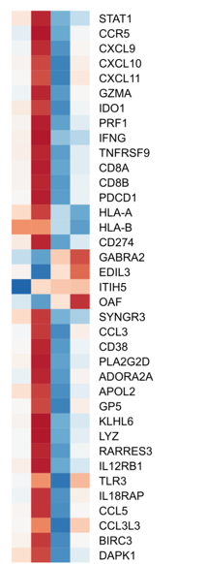
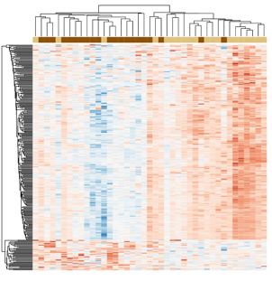
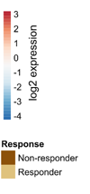
Biomarkers of response - RNAseq
1 2 3 4
IFNy signatures
CD8 T-cell markers and cytolytic immune response
MAPK signatures and general immune signalling pathways
Good responders – before treatment
Good responders – during treatment
Poor responders – before treatment
Poor responders – during treatment
Nur Gide (PhD student) & Querk (Post-doctoral fellow); Long-Scolyer Lab

Slide 27
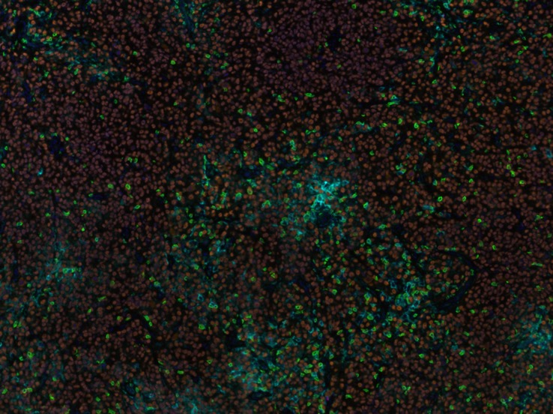
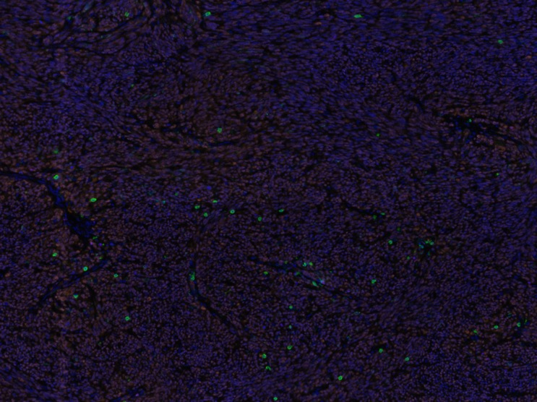
Biomarkers of PD-1 response - Multiplex IHC
Good responder
Poor responder
CD8
PD1
PDL1
FOXP3
SOX10
DAPI
T Nur Gide, PhD Student, Wilmott, Long-Scolyer
Notes:
No FOXp3
PD1 signficantly higher in good vs bad

Slide 28
ctDNA and immunotherapy
A = undetectable throughout
B = detectable then fell
C = detectable throughout

Slide 29
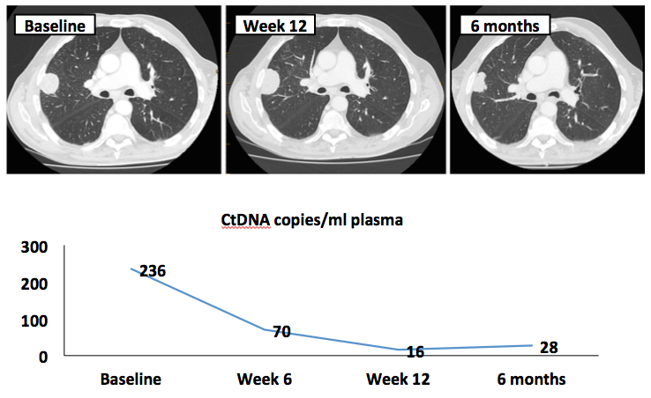
Stage IV Melanoma, Pt MTP

Slide 30
ctDNA and immunotherapy

Slide 31
Immunotherapy for brain metastases

Slide 32
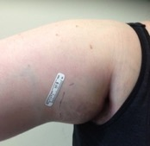
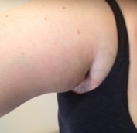
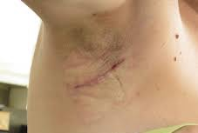
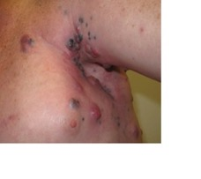
Neoadjuvant Model
Progress?
Stage III Bulky Resectable
Able to have:
  Two Biopsies
  Completion Dissection
PRE Bx
(multiple core)
EDT Bx
(multiple core)
Completion Dissection
Screening
7-14 day
Day 4-7
Week 6-12
DRUG COMBINATION for 6-12 WEEKS
DRUG COMBINATION to
52 WEEKS

Slide 33
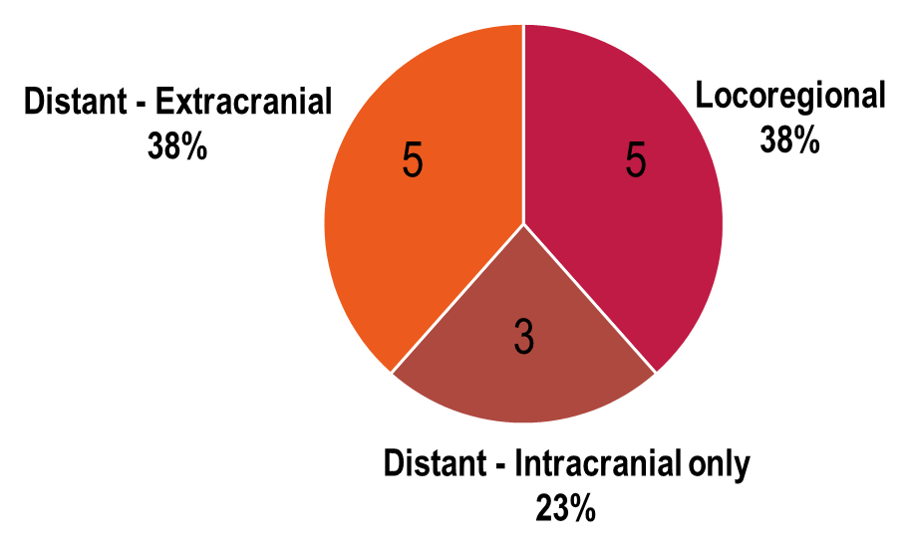
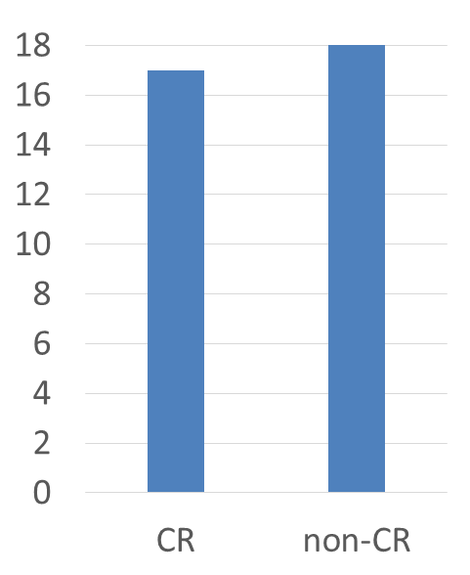

Neoadjuvant BRAF/MEKi
Pathological response at w12
49% pCR
Relapse-free survival
Menzies ESMO 2017
Patient | Mutation | PATHOL. Response | RECIST Response | FDG-PET Response | Baseline DNA* | Recurrence | Follow up (months)
1^ | V600E | CR | CR | CR | 0 | no | +21
2^ | V600E | CR | CR | CR | 43 | local @11 mo D+T | +21
7^ | V600E | CR | CR | CR | 0 | no | +12
10 | V600E | CR | CR | CR | 0 | distant @12mo D+T | +14
12 | V600E | CR | CR | CR | IP | no | +11
13 | V600E | CR | CR | CR | IP | no | +11
14 | V600E | CR | CR | CR | IP | no | +10
21 | V600E | CR | CR | CR | IP | no | +5
3 | V600E | CR | PR | PR | 0 | no | +19
17 | V600E | Non-CR | CR | PR | IP | no | +7
15^ | V600E | Non-CR | PR | CR | IP | no | +9
19 | V600E | Non-CR | PR | CR | IP | no | +5
6 | V600E | Non-CR | PR | PR | 0 | no | +16
16 | V600E | Non-CR | PR | PR | IP | no | +8
4 | V600K | Non-CR | PR | SD | 178 | local+distant @5.5 mo D+T | 15^{Ŧ}
5 | V600E | Non-CR | SD | PR | 0 | no | +15
8^ | V600E | Non-CR | SD | PR | 0 | no | +12
18 | V600E | Non-CR | SD | PR | IP | no | +4
20 | V600E | Non-CR | SD | PR | IP | no | +4
CR RATE |  | 9/19 (47%) | 9/19 (47%) | 10/19 (53%)

Slide 34


BRAF/MEKi - Biomarkers
Ki67
Baseline ctDNA
Higher Ki67 at PRE in pCR (p<0.05)
Lower Ki67 at EDT in pCR (trend)
Menzies ESMO 2017

Slide 35


Clinical Trials App

Slide 36
Research on early phase trials – HOW?
Good staff
Detailed clinical database
Biospecimen collection program and database
Good trials
Strike when the iron is hot!

Slide 37



Acknowledgements
Georgina Long
Richard Scolyer
Matt Carlino
Rick Kefford
James Wilmott (CPC lab)
Helen Rizos (MQU lab)
Maria Gonzalez (trials)
Val Jakrot (biospecimen)
All clinicians (esp surgeons), clinical trials staff, lab staff, biospecimen and data management staff and MIA, USYD, MQU, NHMRC, CINSW…

