Slide 1
Designing Dose-Finding Phase I Clinical Trials
A/Prof Chee Lee
NHMRC Clinical Trials Centre
St George Hospital

Slide 2
Top 10 Qs To Be Discussed With Your Statistician
What is the objective of the design and what are the appropriate endpoints?
How many agents are being escalated?
What should be the target rate of DLT?
What should be the DLT assessment window?
How should DLT be defined?
How many patients do I need?
How many patients should be included in each cohort?
How many doses should be evaluated?
Which patients are considered evaluable for toxicity?
How long will the trial take and when should the trial be stopped?
Lee et al 2021, JCO Precis Oncol 5:317-324

Slide 3
What is the objective of the design and what are the appropriate endpoints?
Traditional cytotoxic phase I trial premise: ↑ dose ≈ ↑ toxicity ≈ ↑ efficacy
Molecularly targeted agents or immunotherapy agents: ↑ dose ≠ ↑ efficacy
  Dose that properly balances the trade-off between specified toxicity threshold and activity
  Other considerations:
    homogeneous patient population
    lag time exists between when the safety and efficacy endpoints
    robust surrogate measures of efficacy

Slide 4
How many agents are being escalated?
No of agents being evaluated simultaneously
    ordering of expected probability of DLT
    Only one agent is being dose-escalated and the dose of other agent(s) is fixed
    Multiple doses of different agents
      Dose escalation for all
      Some dose escalation, some dose de-escalation
      DLT probability for different combination will be different
Model-based designs give the flexibility in the starting of dose and the number of patients per cohort to be used for dose-escalation

Slide 5
What should be the target rate of DLT?
Target DLT rate = acceptable proportion of patients that defines the MTD
Ability to specify a target DLT rate helps to characterise optimal dose
Model-based approaches more flexibility, advantageous in tailoring design according to the class of agent or agents being studied

Slide 6
What should be the DLT assessment window?
Traditional chemotherapy trials, DLT is being assessed during the first treatment cycle (e.g. 28 days)
Might not be suitable for other agents with late onset toxicity, e.g. immunotherapy, radiation therapy
Interest in accounting for DLTs observed beyond cycle 1 in dose allocation and in refinement of the RP2D
Time-to-event CRM use data from partially observed for DLT in the estimation of toxicity probabilities, weighting each entered patient by a portion of the full DLT observation window according to follow-up period

Slide 7
How should DLT be defined?
Traditional cytotoxic phase I trial:
  grade ≥3 non-haematological AEs within DLT assessment window
  grade ≥4 haematological AEs within DLT assessment window
Novel agents can lead to intolerable moderate grade 2 toxicities (e.g. chronic rash, diarrhoea etc from TKI)
Model-based designs that allow for the specification of different tolerance levels for various gradations of AEs e.g. MTD can be defined as the dose that satisfies not only a target DLT rate of 25% but also a target grade ≥2 AE rate of 35%
Composite score of toxicity types and grades e.g. kinase inhibitor weighted toxicity score Carbini et al Clin Cancer Res 2018;24:4968-4975

Slide 8
How many patients per cohort?
Traditional design has fixed cohort size e.g. 3+3 design
Model based approach has more flexibility
Deviation from cohort size, if allowed, needs to be specified (e.g. trial with multiple simultaneously recruiting cohorts, a minimum of one participant per cohort must be assessed until the first DLT is observed and then at least three additional participants per cohort are required).
Also need to specify minimum window between cohorts, particularly for designs that allow dose escalation on the basis of partially observed data

Slide 9
How many doses should be evaluated?
Starting dose is usually one tenth of the LD ₁₀ (i.e., the dose that is lethal to 10% of animals)
Dose levels should be sufficiently different that they are expected to produce different probabilities of AE rates.
Number and range of dose levels are often based on preclinical studies and/or previous studies of similar agents in the class or various formulations of the drug
Implications for the design and the sample size

Slide 10
Which patients are considered evaluable for toxicity?
Protocol needs to define who is evaluable for toxicity
Patients did not complete treatment within DLT window due to disease progression/death – should these patients be replaced?
DLT assessment window needs to be considered in the context of known PFS
If median PFS ≈ DLT assessment window, designs (e.g. TITE-CRM) to use partial information from these patients and reduce the number of non-evaluable patients.

Slide 11
How long will the trial take and when should the trial be stopped?
The expected accrual rate
Duration of DLT evaluation window
Cohort sample size for each dose
$$$
Criteria for stopping are protocol defined
  Achieved the prespecified target sample size
  Designs to allow ongoing recruitment for dose-escalation vs dose-expansion

Slide 12
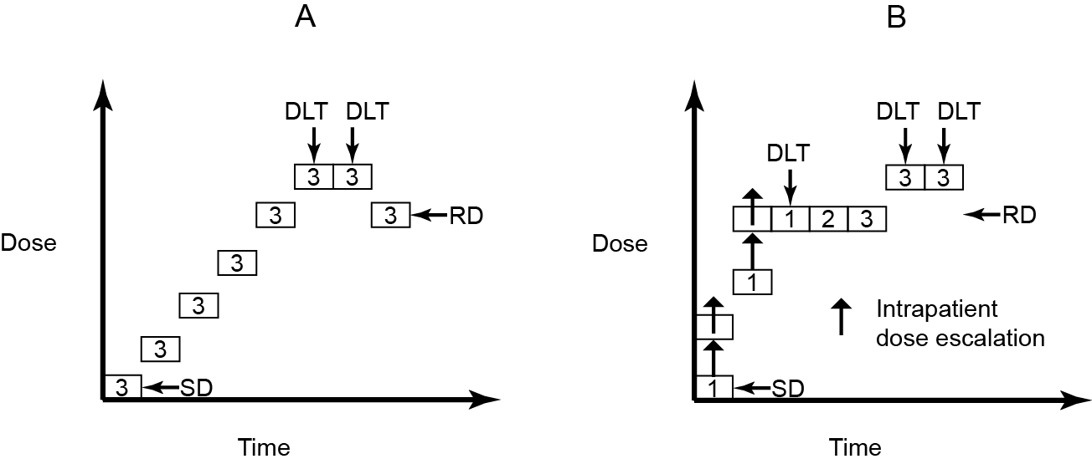
Rule-based approach
Traditional 3+3 design

Slide 13
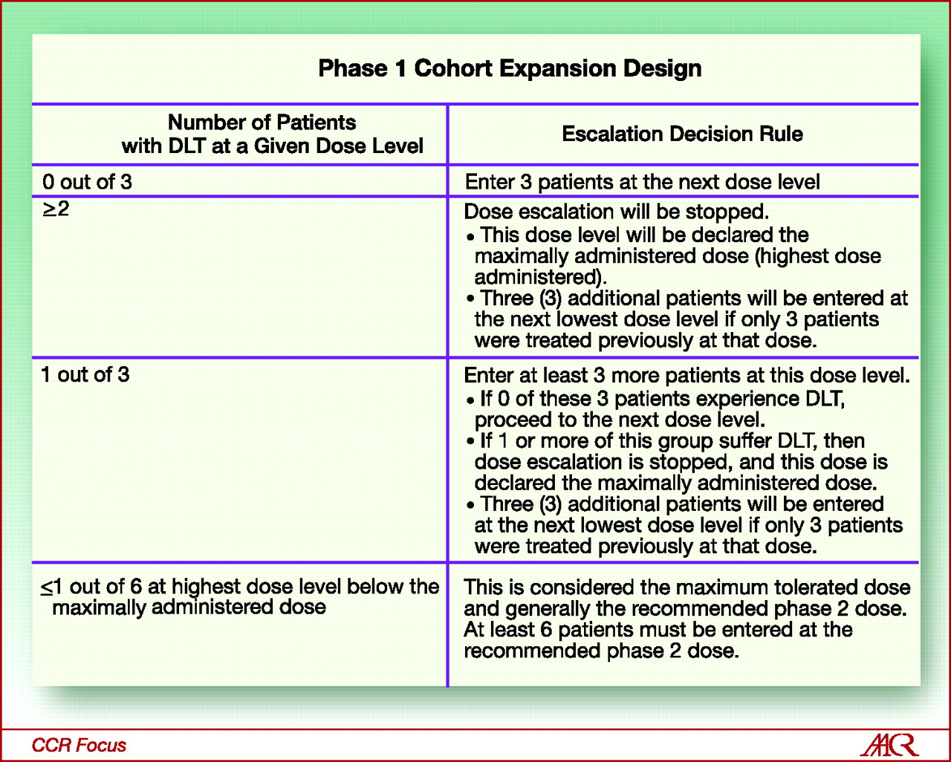
Standard 3+3 design
S. Percy Ivy et al. Clin Cancer Res 2010;16:1726-1736
Notes:
Standard phase 1 cohort expansion design used to determine dose based on toxicity rate.

Slide 14
Accelerated titration design
Different variations
Design 1 – similar to 3+3 design with 40% dose increment per cohort
Design 2 - dose increment of 40%, but there is only 1 patient at each dose level. If 1 DLT during cycle 1, the dose escalation in the accelerated phase will be terminated, dose escalation will revert back to Design 1
Design 3 – dose increment of 100% between individual patient cohorts. If 1 DLT during cycle 1, the dose escalation will revert to Design 1.
Design 4 – dose increment of 100% between individual patient cohorts. If 1 DLT during any cycle, the dose escalation will revert to Design 1.
Simon et al J Natl Cancer Inst 1997, 89(15), 1138-1147.

Slide 15
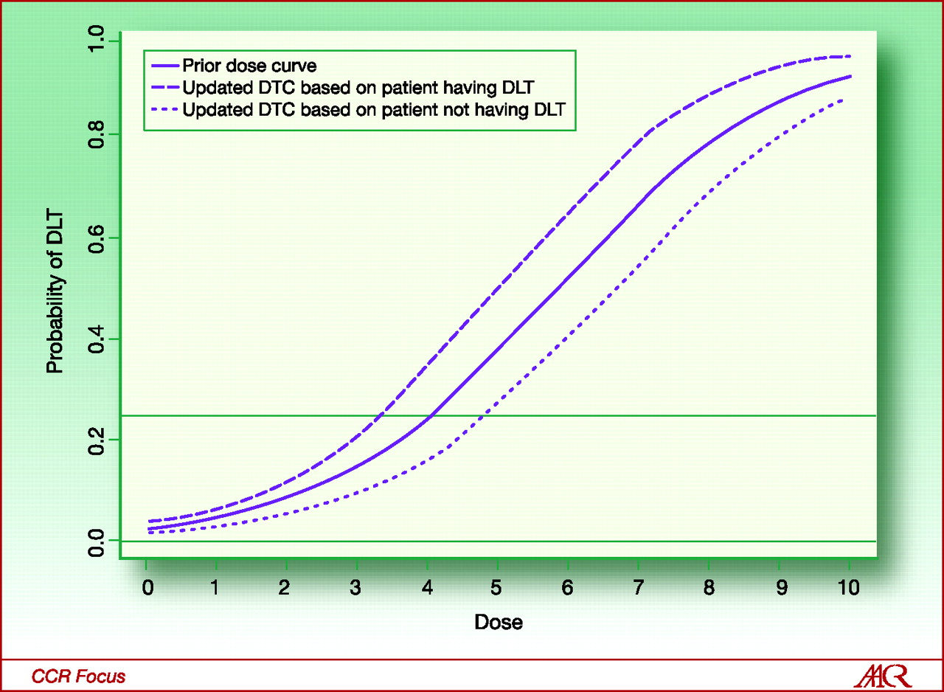
Model based design - continual reassessment method (CRM)
Statistical model to actively seek a dose level by using toxicity data from all enrolled patients. Steps involved:
Pre-specify target DLT rate
Pre-specify number of patients per cohort
Develop a mathematical model of the probability of experiencing a DLT is a function of dose level
Determine stopping rule ≈ sample size
Pre-specified probability DLT

Slide 16
Implementation of Bayesian model based design
specify prior distribution to characterize the shape of curve
Pre-specify target DLT rate
Further refinement of posterior distribution based on next patient without DLT
refinement of prior distribution based on 1st patient with DLT – posterior distribution

Slide 17
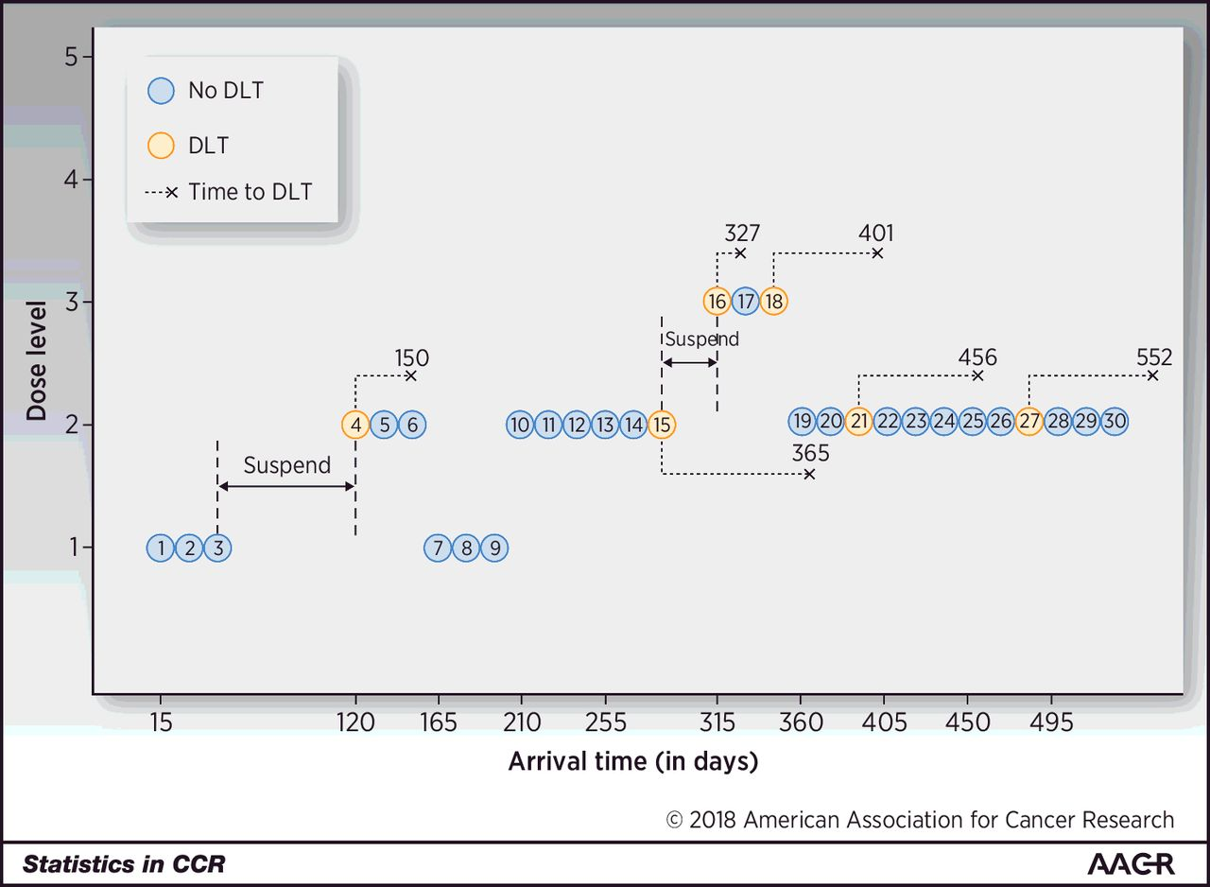
Extension of CRM – TITE BOIN design
1 DLT in 4th patient at 165 days with incomplete follow-up for 5th and 6th patients
Real-time dose assignment decisions for new patients while some enrolled patients’ toxicity data are still pending
Address issues related to late-onset toxicity, rapid accrual and insufficient observation time for toxicity to develop
Multiple DLTs at DL3, de-escalate
2 further DLTs at DL2
Patient 15 with DLT, trial suspended to allow more follow-up time to evaluate at DL2
Dose de-escalation in patients 7-9
First cohort with no DLT at 60 days
Ying Yuan et al. Clin Cancer Res 2018;24:4921-4930
Notes:
Hypothetical phase I clinical trial using the TITE-BOIN design. Patients are treated in cohort sizes of 3, and the number above the “×” indicates the time when DLT occurs.

Slide 18
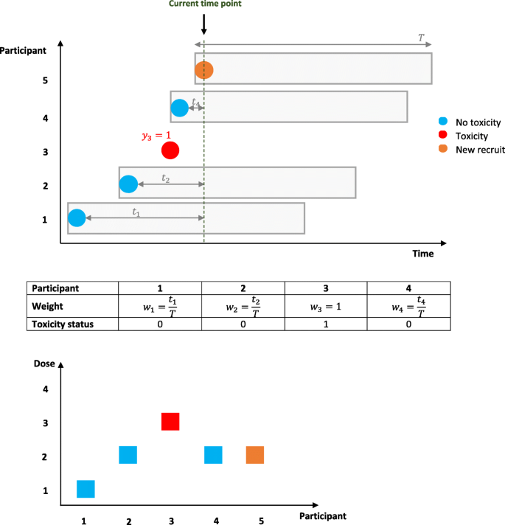
Extension of CRM - TiTECRM
Time-to-Event CRM to account for late-onset toxicities and to allow shorter trial duration
The dose allocated for participant 5, at the current time point, is decided by accounting for all of the available data, which includes the toxicity status and weights of participants 1–4

Slide 19
Conclusion
Traditional rule based designs were developed based on chemotherapy
These designs might be less appropriate for molecularly targeted therapies and immunotherapies
The series of questions help to address the desired research objectives of your phase 1 trials
You need to consult with a statistician in designing your trial and should not apply an “off-the-shelf” method with simple decision processes

