Slide 1
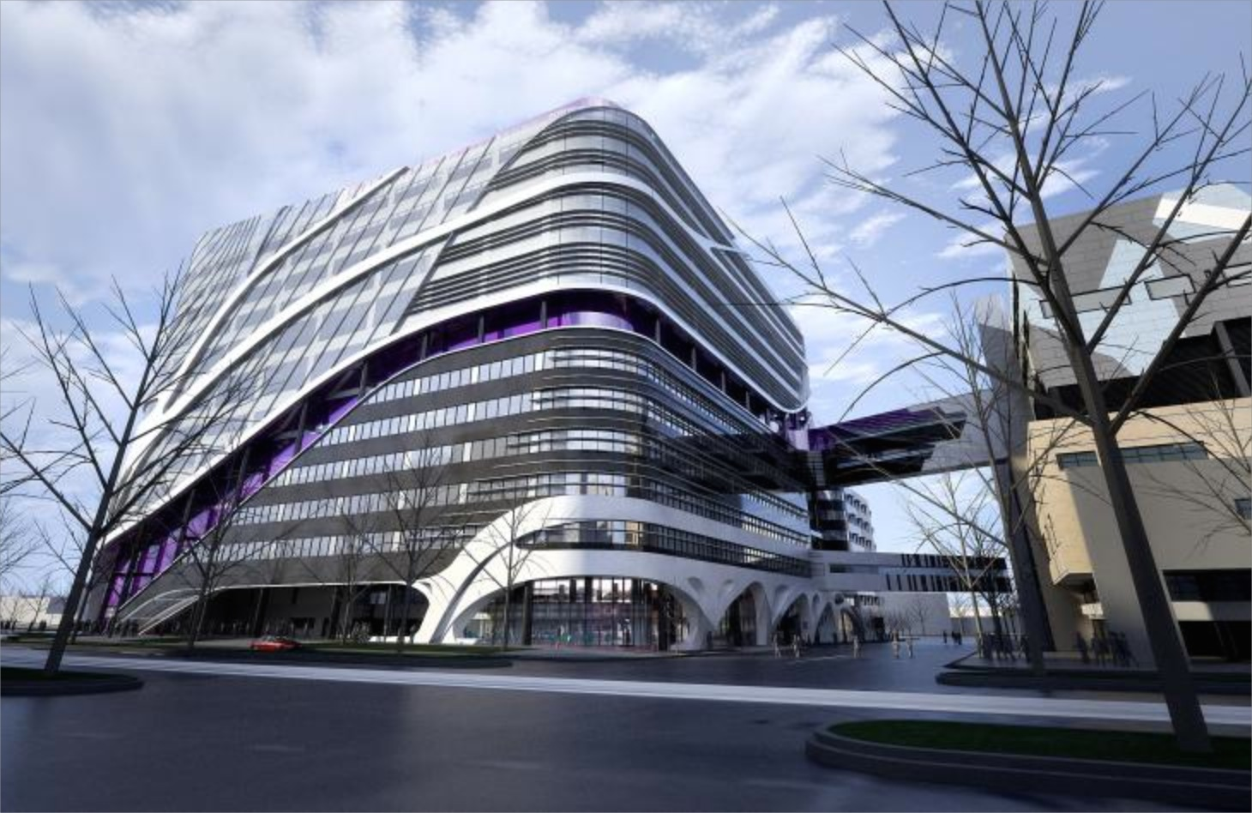



Jayesh Desai
Medical Oncologist
Head of Early Drug Development Trials PCCTU
Peter MacCallum Cancer Centre/Royal Melbourne Hospital
Walter and Eliza Hall Institute

Slide 2
Outline
Cancer Trials Australia (CTA)
    as a Collaborative Model
  Background
  Phase I/Early Drug Development Group
  Evolution of Phase I Group
    Successes and Challenges
  Next steps
Applying this model elsewhere/in NSW?

Slide 3
CTA- Background
Member based organisation of 22 clinical and research sites
Established as the CDCT 1993.
  RMH, PMCC, Austin, LICR, WEHI: Development of G-CSF
Incorporated in 2003 as CTA, Not for Profit Company
Underlying Principles
  Academic network to facilitate clinical/translational research (trials)
  Operational: Central Infrastructure to maintain a clinical network to conduct clinical trials efficiently
    e.g. governance/contracts/ethics/budgets
    Act strategically as an enabler

Slide 4
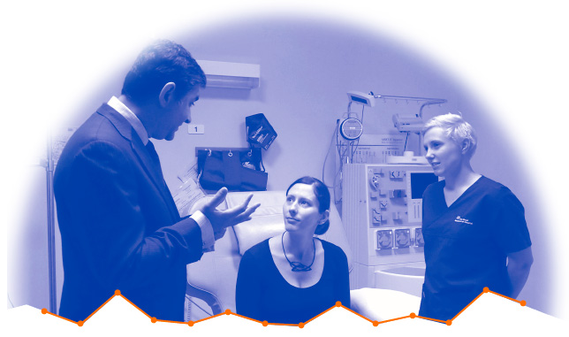



The Phase 1 group:
Early phase cancer trial specialists
Your drug. Our expertise.
A successful combination to manage your clinical trials

Slide 5

A single point of contact
to a wide Phase 1 network

Slide 6
Evolvement of CTA- Phase I Group
Continued growth in activity
Group’s members conduct 50-60 Phase I trials
  20 Haem, 15-20 FTIH. 80% big pharma
Original 3 and 2 more recent Phase I clinical sites
  RMH: strong focus on Ph1 within unit’s portfolio, translational drive though WEHI, strengths in Haem, Brain, CRC, Breast, strategic relationships/CoE
  PeterMac: focus on translation opportunities, strengths in melanoma, lung, haem, strategic relationships (eg. Pfizer…........Roche/Genentech, BMS)
    Combined program with approx 40 Phase I trials, I/O focus, evolve from Reactive to Pro-active
  Austin: (Hui Gan) Ludwig programs, strong drive in Solid tumours
  Monash: (Ben Markman) Steady growth over 6 years. 10-15 Ph1’s.
  Lifehouse: (Lisa Horvath)Joined group 5 yrs ago, mentorship/network objectives

Slide 7
Evolvement of CTA- Phase I Group
Underlying Principles
Academically driven, high quality Phase I’s. Not ”contract research”
Work closely with Biotech
  Assemble a large group as a “One-Stop Shop” following on from CDCT
    Signiifcant depth and breadth of expertise
    Clinical, drug-development expertise
    Translational/biology
    Other, eg. Pharmacodynamic, Molecular Path
    Operational: Regulatory guidance, budgets etc
    Partners included: Bionomics, Engeneic, UNSW (PENAO), Beigene
Provides trials and opportunities, and
Strong culture of providing mentorship to sites/investigators
Information exchange/sharing of “IP”
Strategic Initiatives

Slide 8
Grant McArthur
Andrew Haydon
Jonathan Cebon
Mark Shackleton
Catriona McNeil
Andrew Roberts
William Rennick
John Seymour
Simon Harrison
David Ritchie
Miles Prince
Andrew Grigg
Jeff Szer
Translational and
drug development
expertise
Michael Michael
Jayesh Desai
Niall Tebbutt
Peter Gibbs
Gastro
Intestinal
Melanoma
Hematological
Geoff Lindeman
Richard de Boer
Sherene Loi
Jane Beith
Ben Solomon
Linda Mileshkin
Paul Mitchell
David Ball
Hui Gan
Breast
Lung
Phase 1
Guy Toner
Andrew Weickhardt
Lisa Horvath
Shahneen Sandhu
Mark Rosenthal
Ben Tran
Urological
Gynecological
Danny Rischin
Linda Mileshkin
Michael Quinn
Anne Hamilton
Head & Neck
Sarcoma
Danny Rischin
Ben Soloman
Hui Gan
Jayesh Desai
Brain
Mark Rosenthal
Kate Drummond
Hui Gan

Slide 9
Grant McArthur
Jonathan Cebon
Mark Shackleton
Preclinical expertise
and support
Melanoma
Andrew Roberts
Nick Nicola
Warren Alexander
David Huang
Andreas Strasser
Kylie Mason
Ricky Johnstone
Mark Dawson
Tony Burgess
Matthias Ernst
Wayne Phillips
Rob Ramsay
Oliver Sieber
John Mariadason
Jayesh Desai
Gastrointestinal
Hematological
Preclinical
Jane Visvader
Geoff Lindeman
Ian Campbell
Robin Anderson
Sherene Loi
Lung
Breast
Neil Watkins
Ben Solomon
Tom John
Marie-Liesse
Asselin-Labat
Gynecological
Urological
David Bowtell
Claire Scott
Wayne Phillips
Gail Risbridger
Patrick Humbert
Lisa Horvath
Ygal Haupt
Brain
Terry Johns
Mark Rosenthal
Richard Shaffery

Slide 10
Key Projects/Initiatives
HRE Application
FTIH Application
FTIH Advice

Slide 11
Key Projects/Initiatives
HREC approval process/MAP
Ability to conduct FTIH trials without the need for an IND application
60 days to HREC/Governance approval
HREC Application
HRE Application
  One HREC application for all of CTA’s clinical sites
  CTA compiles HREC submission within 15 days
  Approval time can be reduced if no scientific or ethical queries are received
FTIH Application
CTA assists with the preparation of FTIH submission
FTIH Application
  Developed under the Clinical Trial Notification (CTN) scheme, no IND required
FTIH Advice
10 days to evaluate data within HREC approval period
FTIH Advice
  Preclinical data examined by independent expert panel
  Panel advise on data readiness for clinical trial
  to facilitate HREC approval
FTIH: First time in human
HREC: Human research ethics committee

Slide 12
Key Projects/Initiatives
Active input into the Regulatory Process:
Personalised Medicine
  Molecular testing protocol (ALK and beyond), referral pathways
Coordinated Grants
  VCA and CCV: eg.TrialMatcher
  MGHA: solid tumours
  CRC/CTX2: Clinical partner
Strategic Reviews
  Annual, + Extensive reviews Julian Clark/WEHI Bus Dev,
  Deloitte/CTA: trial costings
Marketing efforts
Educational programs and scholarships: Melb Uni, Mol to Medicines
Trials App with CCV

Slide 13
Next Steps
Changes++ in Victoria
  VCCC, Monash, Austin
  Lifehouse
  Focus on consolidation of programs at a site level
  Sites are now mature and “independent”
  Network to continue to enhance activity, communication
  Initiatives around referral pathways, personalised medicine, I/O

Slide 14
Summary: Value of Collaboration?
Challenges
  Competing interests: investigator, site
  Managing expectations: from sites/investigators and from sponsors
  Collaboration requires give and take
  Defining Phase I success requires a long-term view
  Sites need to invest in resources themselves
  Not an automatic way to get Phase I trials

Slide 15
Summary: Value of Collaboration?
Challenges
  Competing interests: investigator, site
  Managing expectations: from sites/investigators and from sponsors
  Defining Phase I success requires a long-term view
Positives
  Mentorship and knowledge sharing has been outstanding
    Not only reliant on what our own institutions can provide
  Depth and breadth of expertise and resources offered through the network
  Sharing of platforms/expertise
  Facilitate Australian Biotech
  Ability to develop larger strategic initiatives, funding/grants
  Develop a more sophisticated operational model, educating HRECs
  Clearly generated more trials for us

Slide 16
Summary: Value of Collaboration?
Challenges
  Competing interests: investigator, site
  Managing expectations: from sites/investigators and from sponsors
  Collaboration requires give and take
  Defining Phase I success requires a long-term view
Positives
  Mentorship and sharing of our IP has been outstanding
    Not only reliant on what our institutions can provide
  Depth and breadth of expertise and resources offered through the network
  Sharing of platforms/expertise
  Ability to develop strategic initiatives, funding/grants
  Develop a more sophisticated operational model
  Clearly generated more trials for us
The only way of competing in an Internationally Competitive space

