Slide 1


Clinical trial access to regional, rural and rare cancer patients using telehealth
Professor Sabe Sabesan
Director of Medical Oncology, Townsville Cancer Centre
&
Australian Institute of Tropical Health and Medicine
James Cook University, Townsville

Slide 2
Access to clinical trial is limited for rural, regional and rare cancer patients
Clinical trials are regarded as best management options for cancer patients
Across Australia, rate of enrolment in clinical trials is lower than international recommendations
For rural, regional and rare cancer patients, rate of enrolment is even lower
Main barriers are—availability of trials closer to home, cost and inconvenience of travel

Slide 4
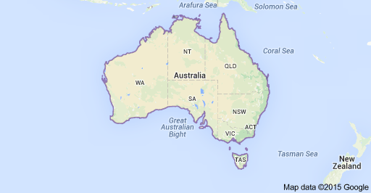
Problem:
Limited access to clinical trials for rural and regional patients
Despite advances in technology based care, access to clinical trials for rural and regional patients and for patients with rare cancers(even within a large metro) remains limited for many reasons in Australia and around the world.
TILs- Trials in large centres

Slide 5
What do we need to do to improve rate of enrolment and access?
Enhancing Australian trial capabilities is one of federal and state governments’ priorities:
Funding to improve trial capabilities through training-by NHMRC
to establish Industry growth centres such as MTP connect
other funds for state govts
2. Making clinical trials as core business of health services
3. Use of telehealth to connect regional and rural sites to major centres and provide trial medications closer to home

Slide 6
Teleoncology enabled clinical trial models (Teletrial model)
Interconnected clinical trial systems/networks linked by telehealth

Slide 7
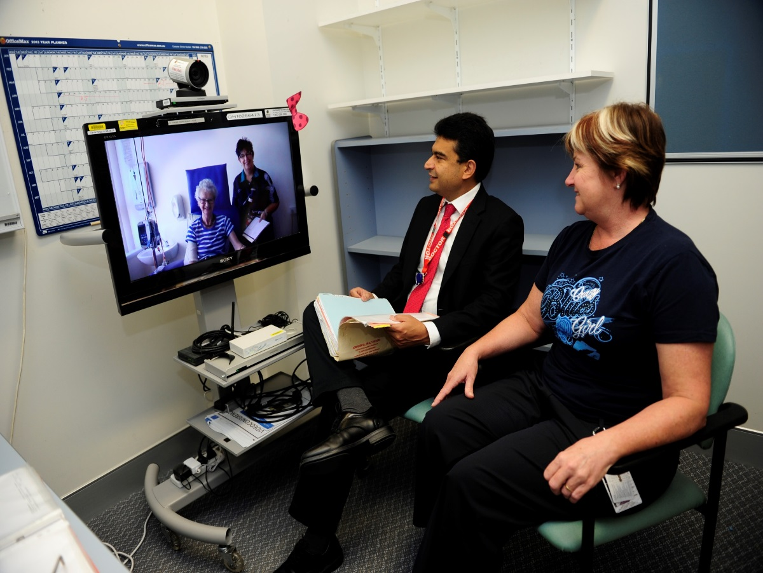
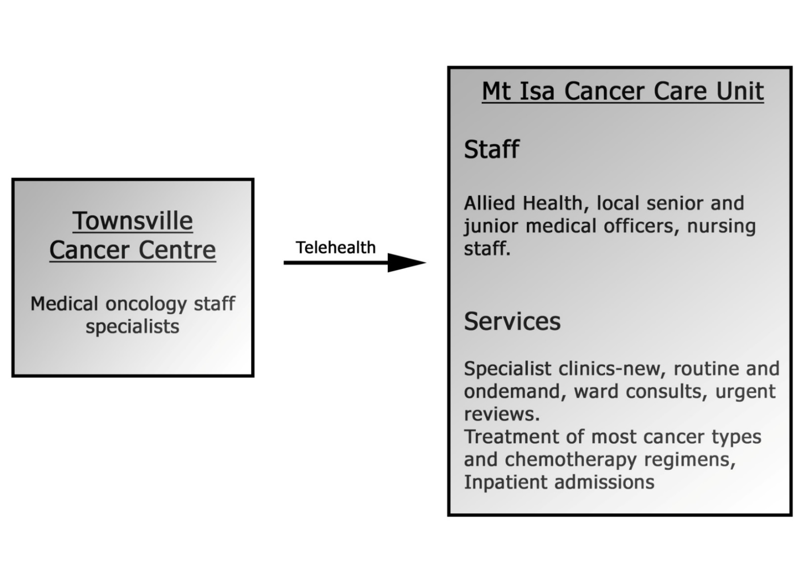
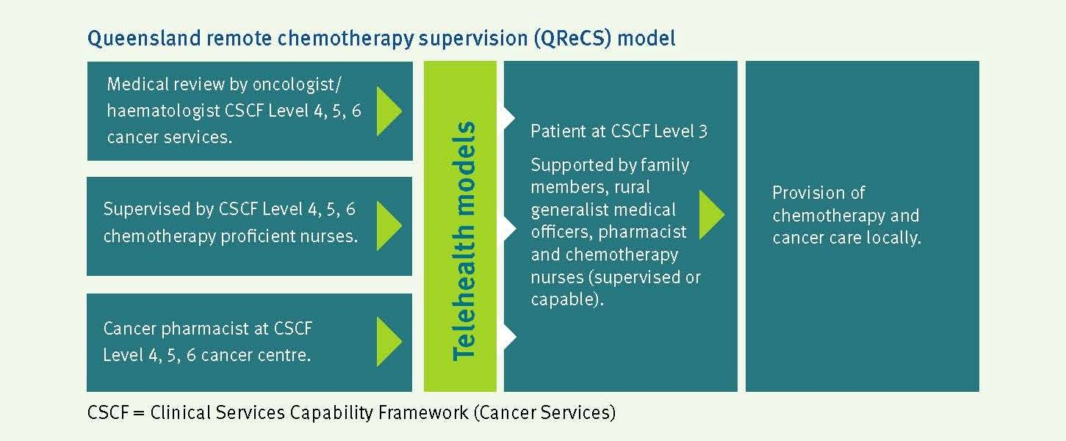
Why telehealth?

Slide 8
Canadian models
Kansas University model
Summary of the literature
Townsville Teleoncology Model
Feasible to provide comprehensive services
Sabesan et al, IMJ 2012, Doolittle et al 2006
Improved waiting times
Sabesan et al, AJRH 2014
Acceptable to patients and health
professionals
Mooi et al 2012, Doolittle et al 2007
Seems Safe to supervise chemotherapy remotely
Chan et al, MJA 2015
Saves money to the health system
Thaker et al, MJA, 2013, Doolittle et al 2006
Expanded rural scope of practice and Improved rural workforce
Sabesan and Zalcberg, NEJM 2018

Slide 9
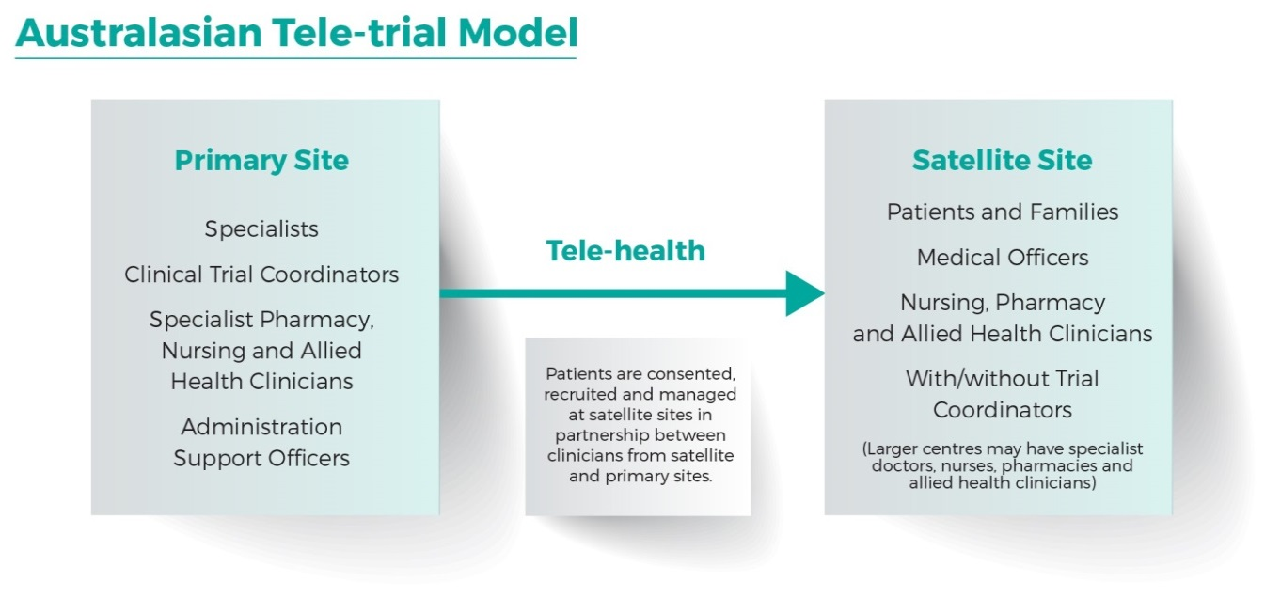
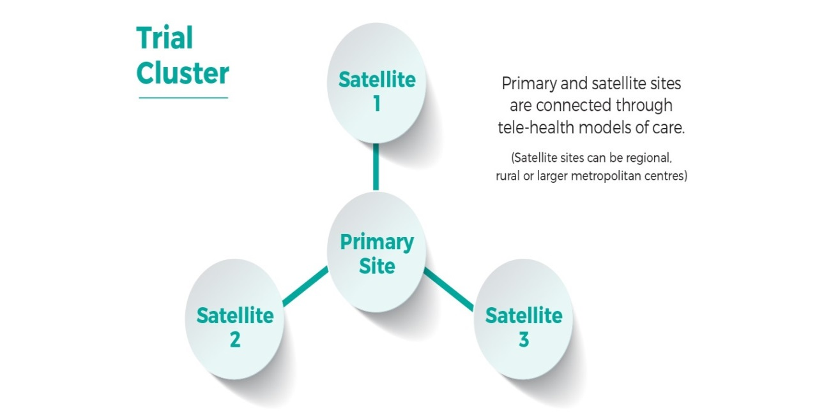

Slide 10
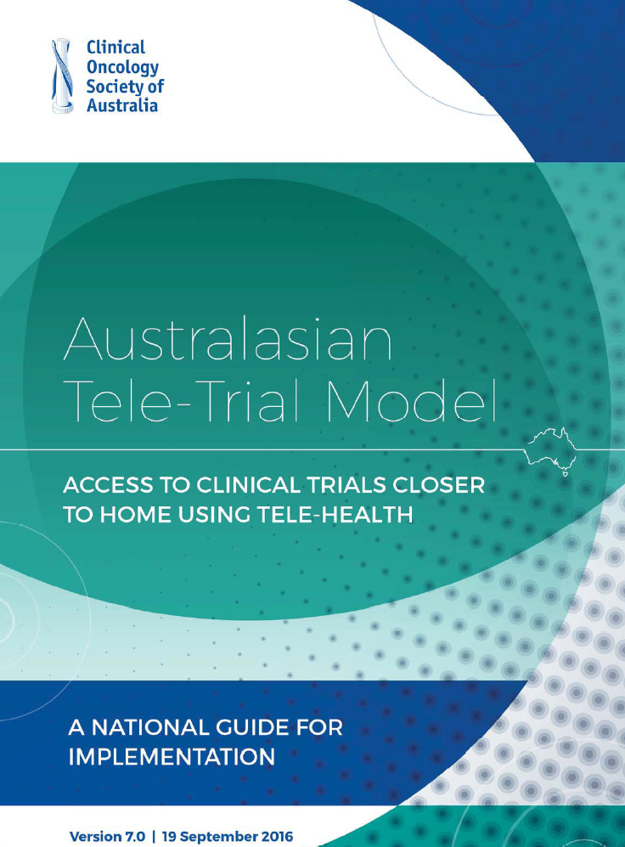
Ethical and safe conduct of clinical trials using this model requires that the following aspects are considered and addressed by implementation plans
Primary site is the coordinating site and remunerated accordingly
Selection of satellite sites and suitable trials including accreditation of sites, supervision plans and site visits
(2) Work force
(3) Good clinical practice
(4) Roles and responsibilities
(5) Training for individual staff, site initiation meetings and trial updates
(6) Technology and support
(7) Participant screening and recruitment
Obtaining participant consent
(8) Medication handling
(9) Managing and reporting serious adverse events
(10) Patient reported outcomes
(11) Documentation and reporting
(12) Financial considerations
(13) Regulatory considerations, Indemnity,
Insurance and
clinical trial agreements

Slide 11
Implementation at state and national levels
COSA Teletrial Consortium and steering committee for national implementation
Co-Chairs:
Prof Sabe Sabesan(Townsville) & Prof John Zalcberg (Monash)
(Chantal Gebbie-Project Officer)
Members of the consortium:
COSA, Medicine Australia and members, Trial groups, Cancer Voices, Rare Cancer Oz, WEHI, Garvan, AITHM, ICON cancer care, St John of God and others.
Plans are underway:
Victoria: VCCC, Monash and Regional network
Qld: State-wide Teletrials Working group
(State-wide cancer clinical network)
NSW: Westmead/Orange, St Vincent’s/Wagga/Tamworth
SA: Flinders/Mt Gambier
Reforms occurring in SSA, sub-contracts and trial related SOPs

Slide 13
Governance and process Reforms
Queensland Health
Streamlined SSA Form incorporating tele-trial sub form in development
Revision of clinical trials Standard Operating Procedures incorporating Tele-Trials
Medicine Australia
Development of Medicine Australia sub-contract template
COSA Teletrials Departments of Health advisory group
In principle agreement to adopt uniform processes across Australia

Slide 14
Progress so far:
Orange/Dubbo cluster has enrolled three patients already in ASCOLT(AGITG) trial
Pilots---MonarchE adjuvant breast cancer phase 3(Ili Lilly) trial in Northern and Gold Coast clusters
How is this model applicable to early phase trials?
A tool for making connections with smaller centres who otherwise would not be aware of early phase trials at larger centres and thus not referring patients for early phase trials
Ability to screen and follow up more patients remotely
Ability to connect with other phase 1 centres and conduct collaborative early phase projects
Ability to establish early phase trial networks/clusters

Slide 15

Greetings from Townsville

