Slide 1
Update on regulatory processes in Australia
1. ORBIS
2. Provisional approval
Michael Coory BSc(Stats) MBBS PhD(Med Stats) FAFPHM
Faculty of Medicine, Dentistry and Health Sciences, University of Melbourne
Mater Medical Research Institute, University of Queensland

Slide 2
ORBIS

Slide 3
ORBIS oncology and malignant haematology medicines
FDA
TGA
Health Canada
MHRA (UK)
SwissMedic
Singapore
(Brazil)
ORBIS: by invitation

Slide 4
Medicines are global commodities
Scientific assessments: standardised across countries
Marketing approval
important sovereign decision for each national regulator to make

Slide 5
ORBIS applications approved by TGA as at Mar 2021
pembrolizumab/ lenvatinib | 2L microsatellite stable advanced/metastatic endometrial cancer
acalabrutinib | Mantel cell leukaemia chronic lymphocytic leukaemia
cedazuradine decitabine | intermediate or high risk myelodysplastic syndrome
ripretinib | 4+L advanced/metastatic GIST
tucatinib | 2+L metastatic HER2+ breast cancer
nivolumab ipilimumab | advanced/metastatic NSCLC with 2 cycles of chemotherapy
atezolizumab bevacizumab | unresectable HCC
ibrutinib | chronic lymphocytic leukaemia
pembrolizumab | MSI-H metastatic CRC
commenced
Sep 2019
9 complete
21 under evaluation

Slide 6
Benefits
Faster understanding of the benefits and toxicities of medicines
Smaller companies might be more likely to bring medicines to Aus
Faster access for Australian patients
Risks
Group think

Slide 7
Provisional approvals

Slide 8
Provisional approvals in Australia
Early, temporary approval, partway through the clinical development program
unmet need in the setting of a lethal cancer
compelling treatment effect

Slide 9
codified in legislation in July 2018
Indication
This indication was approved via the provisional approval pathway, based on objective response rate and duration of response in a single-arm trial. Full registration for this indication depends on verification and description of clinical benefit in confirmatory trials.
confirmatory studies: underway at the time of provisional approval
checkpoints at 2 and 4 years: TGA must make an active decision to continue
6 years: automatically removed from the market,
unless converted to regular approval

Slide 10
Typical characteristics of regular versus provisional marketing approval
 | Regular | Provisional
Study design | Phase3 Randomised | early phase trial single-arm small randomised
endpoint | RFS, PFS, OS | ORR, DoR
Treatment effect | varies | compelling, large
GRADE: quality-of-evidence | high | moderate false-positive rate ~ 10%
% of onc/mlg-haem approvals (US) | 66% | 33%
Clinical dev program complete | yes | no
Confirmatory study needed | no | yes often higher up the algorithm outside the provisional indication
Indication | varies | niche (small number of patients) unmet need in a dire cancer

Slide 11
provisional regulatory approvals for cancer medicines in Australia
 | indication
pembrolizumab | tissue agnostic MSI-H
lorlatinib | ALK+ NSCLC
atezolizumab | TNBC
pembrolizumab lenvatinib | 2L MSS endometrial
entrectenib | tissue agnostic NTRK
larorectinib | tissue agnostic NTRK
cemiplimab | locally-advanced SCC skin
venetoclax | AML
enasidenib | AML IDH2
acalabrutinib | Mantel cell lymphoma
Commenced Jul 2018
10 approved
11 under assessment

Slide 12
FDA: (accelerated)
1992, HIV
EMA: 2007 (conditional)
TGA: 2018 (provisional)
Covid vaccines have been approved via the provisional pathway

Slide 13
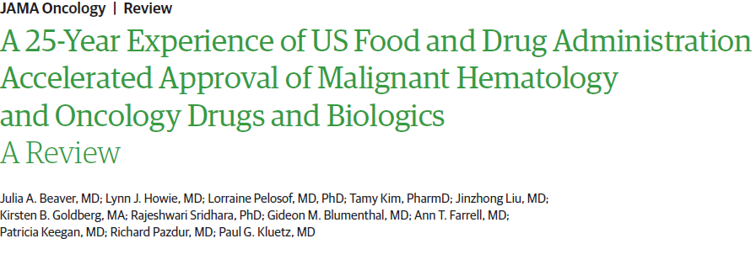
onc/mlg.haem
one-third of approvals are accelerated
5/51 not confirmed by subsequent Phase3 study
false-positive rate ~ 10%

Slide 15
FDA after 2017
2018: olaratumab (sarcoma): small Phase2 RCT: PFS and OS
not confirmed in Phase3 RCT, neither for PFS nor OS
random variation/statistical noise/chance
realised confounding/baseline imbalances

Slide 16
Dangling accelerated approvals
2021: voluntary withdrawals of
durvalumab and atezolizumab: 2+L m.UC
nivolumab and pembrolizumab: 2+L SCLC
Apr 2021: FDA ODAC
atezolizumab and pembrolizumab: cisplatin/carboplatin ineligible 1L m.UC
nivolumab and avelumab: 2L m.UC
nivolumab: 2L adv.HCC
atezolizumab: 1L TNBC (with nab-pac)

Slide 17
Wong, C. H., K. W. Siah and A. W. J. A. a. S. Lo (2019).
"Estimating clinical trial success rates and related parameters in oncology.“
https://papers.ssrn.com/sol3/papers.cfm?abstract_id=3355022
In general oncology medicine development
Failure rate of Phase3 after positive Phase2: 50% - 75%
accelerated/conditional/provisional approval
failure rate of the confirmatory Phase3: 10%
Background clinical knowledge (the data does not speak for itself)
niche indications with no effective treatments (unmet need)
promising/compelling early data of major therapeutic advance

Slide 18
Patients with serious, life-threatening diseases (and their families, and the doctors who care for them) have repeatedly stated their willingness to accept more uncertainty, in a trade-off for faster access. They point out that their lives may be the cost of waiting for RCTs with late endpoints (e.g., OS) to report.
If the accelerated approval program resulted in the same false-positive rate as regular approvals, it would be setting a higher than intended bar.

Slide 19
Early-phase studies partway through the clinical development program, under certain circumstances
can provide moderate-quality evidence (false-positive rate: 10%)
of a major therapeutic advance
in the context of unmet need for a lethal cancer
leading to an early temporary provisional approval
with Phase3 data on the way
This may align with some patients preferences and values, thereby providing some patients with an additional therapeutic option.

