Slide 1

Pharmacokinetics Tools for Early Phase Trials or
Personalised Therapy by
Dose Optimisation
Stephen Ackland
Director, Hunter Cancer Research Alliance,
University of Newcastle
170323
Drug Development 2017
Garvan Institute

Slide 2
Six Points
1. TDM can improve delivery of established drugs
  5FU
  Sunitinib
2. TDM is now clearly feasible for many drugs
  TAT <1 week
  LC-MS/MS, immunoassay, etc.
3. Phase I trials should include adequate PK
  clear determination of PK properties of agent
  dose-exposure relationships
  PD endpoints

Slide 3
Six Points (2)
4. Phase II trials should include drug PK
  exploration of doses (randomised?)
  explain PK/PD variability
  sparse PK sampling
5. Phase III trials should include pop PK sampling
  explain PK/PD variability
6. TDM should be considered in post-marketing
  individualised dosing

Slide 4
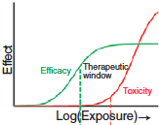
Current Approach to Dose Selection Needs Improvement
inability to find best dose for registration trials is common contributor to denial of NDA by FDA (Sacks LV, JAMA 2014)
significant issues in cancer:
  narrow therapeutic index
  area of need = rushed development
  finding right dose considered less impt. by sponsor
approvals of some agents at doses too high or too low
  zoledronate (Himelstein AL, JAMA 2017)
  trastuzumab – Css low in 25% gastric ca
  sunitinib – flat 50mg dose suits few
  omacetaxine – clearance does not correlate with BSA; RR lower in females, dosing for renal/hep dysfunction not determined

Slide 5
Cancer Clinical Trials
efficacy signals
MTD, RP2D
no assessment of inter-patient variation
  dose-response/exposure-response rarely evaluated
  high rate of dose reduction; no dose increase
  ?optimum biological dose << MTD
no assessment of cumulative long-term toxicity

Slide 6
TDM in Cancer
Currently:
  HD MTX
  mitotane
  busulfan
  13-cis-RA
Opportunities:
  5FU
  imatinib
  sunitinib
  other nibs
  mTOR inhs
  MoAbs
  all new agents
Prerequisite features:
narrow therapeutic index
large interpatient variability
exposure-response relationship

Slide 7
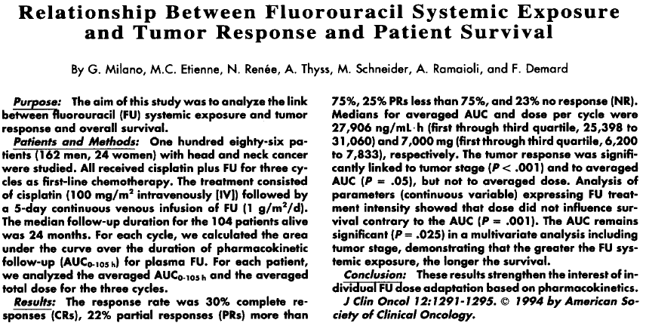
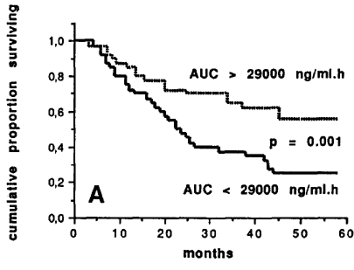

Slide 8
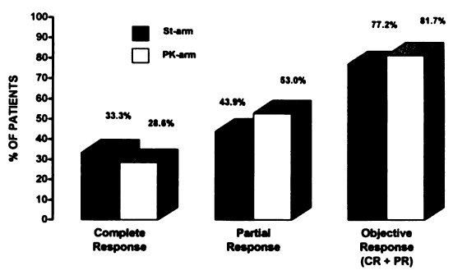
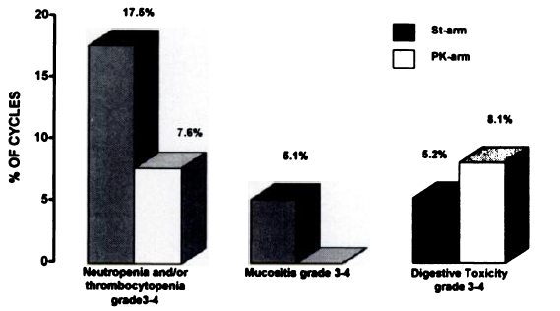
RCT: PK-guided 5FU dosing in H&N Ca
122 patients
5FU 1g/m2/d civ x 4d (3 cycles)
Standard dosing vs PK-guided
Fety et al, Clin Ca Res 1998

Slide 9
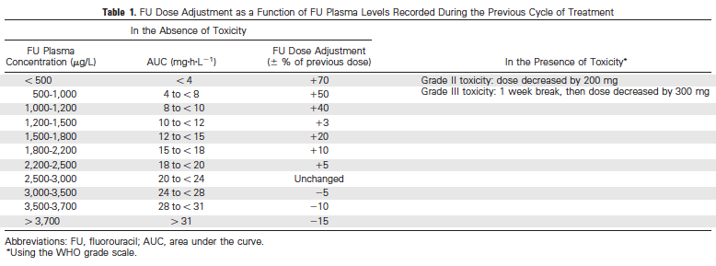
Gamelin et al JCO 2008
5FU 8hr infusion weekly

Slide 10
Gamelin et al JCO 2008
RCT in mCRC
  Arm A
    standard dosing BSA 1500 mg/m2, adjusted for toxicity (n=104)
  Arm B
    TDM and weekly adjustment to AUC 20-24 (n=104)
  Arm B mean dose 1790 mg/m2 (900-3300)
  ORR A:18%, B:34%
  med OS A: 16mo, B: 22mo

Slide 11
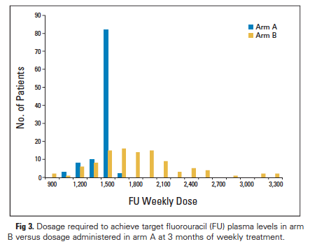
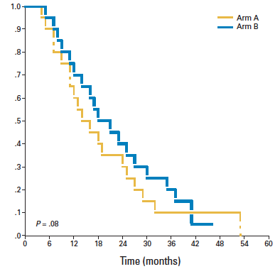
Individualized 5FU dosing in metastatic CRC
A: 1500 mg/m2, 8hr infusion, weekly (n=104)
B: PK- adjusted → AUC 20-24 mg.hr/L (n= 104)
Arm B mean dose 1790 mg/m2 (900-3300)
Median OS:
A: 16 mo
B: 22 mo
Survival probability
Response rate:
A: 18%
B: 34%
Gamelin et al J Clin Oncol 2008

Slide 12
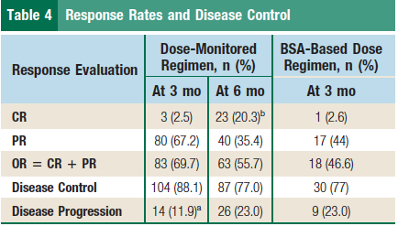
Individualised 5FU dosing in metastatic CRC
non-randomised comparison, 1L FOLFOX (46h inf Q2w)
118 pts PK-monitored, dose-adjusted → AUC 20-24
  5FU dose increased 64%, decreased 19%
39 similar pts (different hospitals), standard BSA dosing
  5FU decreased >10% in 4
Toxicity:
Diarrhea: 2 vs 12 %
Mucositis: 1 vs 15%
Neutropenia: 18 vs 25%
Median OS:
PK-adjusted: 28 mo
Standard: 22 mo
Capitain (and Gamelin)
Clin Colorectal Ca 2012

Slide 13
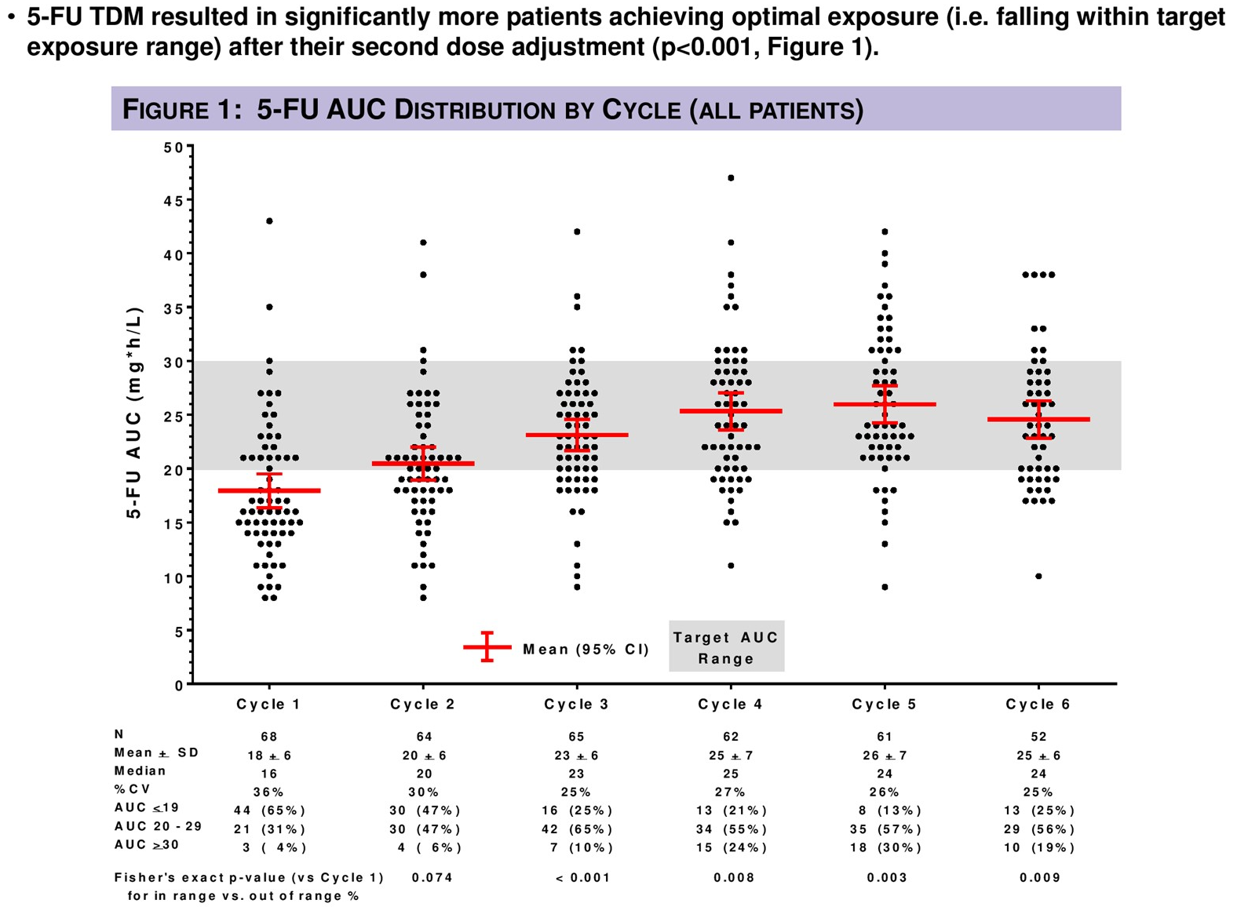
Salamone et al ASCO GI 2017

Slide 14
Deflexifol: a new formulation of 5FU phase I trial, 46 hr infusion
Median AUC toxicity
(Hillcoat et al, Br J Cancer 1978)
No AUC trend with dose
Only one patient had AUC above median for toxicity
1200 1800 2400 3000 3600mg/m2
Clingan, Ackland et al. ASCO 2017

Slide 15
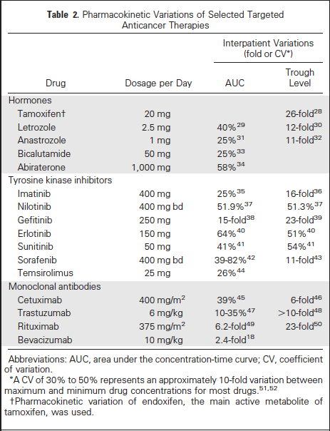
PK Variability of Targeted Therapies
Fixed Dosing
Gao et al J Clin Oncol 2012

Slide 16
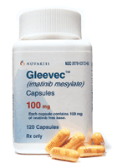
Imatinib

Slide 17
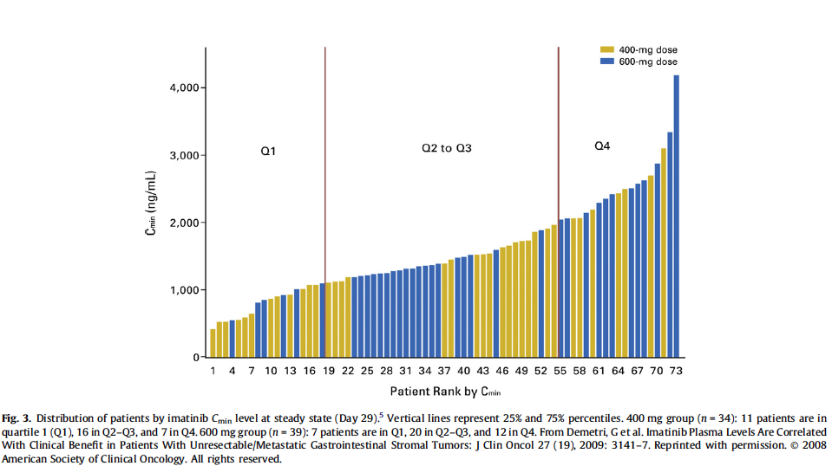

Imatinib- substantial interpatient variability
rapid absorption
independent of food
95% protein bound
1100 ug/L →
KIT exon 11 mutations:
Demetri et al, JCO 2009

Slide 18
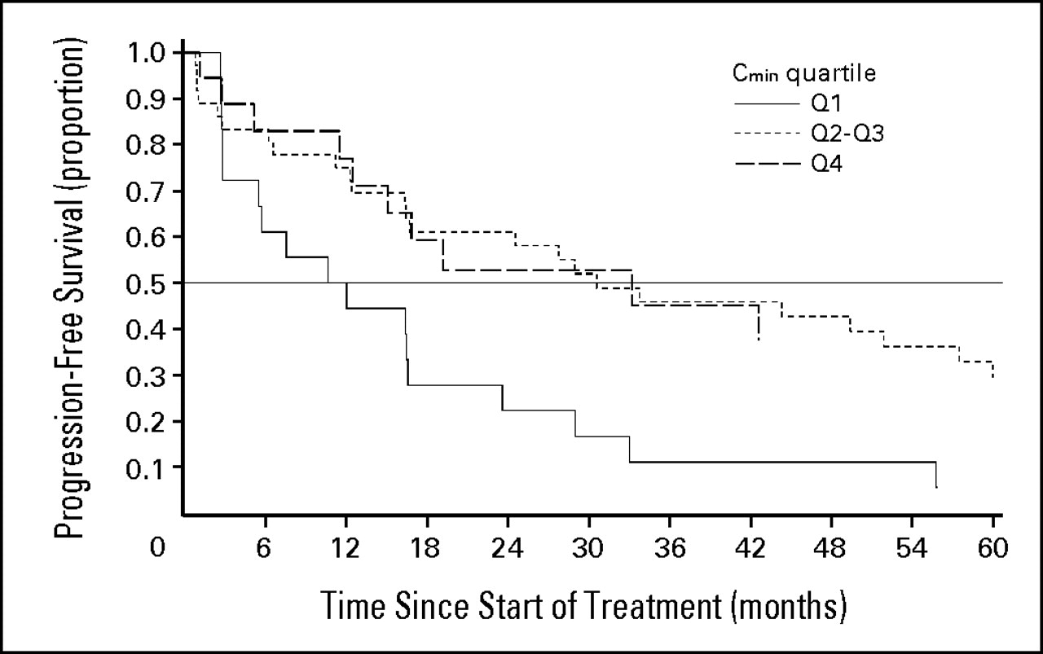
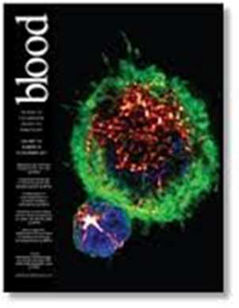
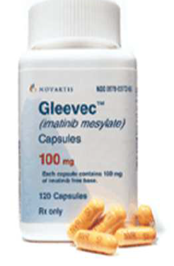
Imatinib in CML: plasma exposure drives PD, not dose
Q2,3,4 = Cmin >1000 ug/L
Q1 = Cmin <1000 ug/L
Piccard, Blood 2007

Slide 19
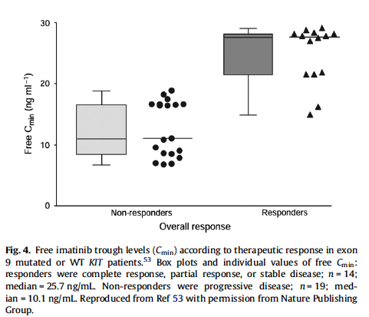
Imatinib Trough Level Correlates with Response in GIST
from Widmer N, BJCa 2010

Slide 20
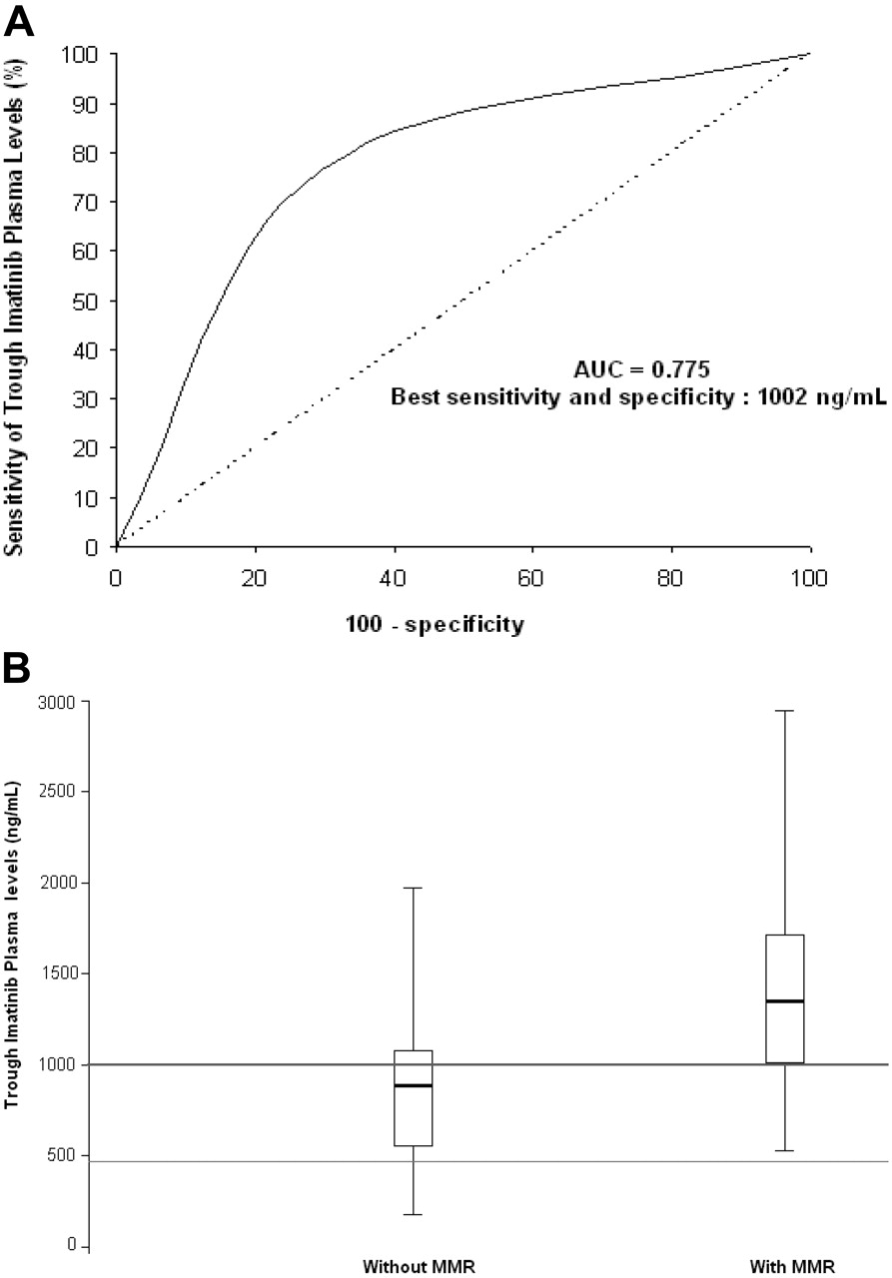

….. And in CML
Trough plasma imatinib threshold for major molecular response (MMR)
68 patients
- CP CML 40
- AP CML 18
- IM dose 400 or 600
Odds Ratio 7.8 , P <0.01
1000 ng/ml
no MMR (34) MMR (34)
Stephane Picard et al. Blood 2007;109:3496-3499
©2007 by American Society of Hematology
Notes:
Trough plasma imatinib threshold for major molecular response (MMR).(A) Receiver operating characteristic (ROC) curve analysis. Regarding trough imatinib plasma levels and their discrimination potential for MMR, the area under the ROC curve (AUC) was 0.775, with best sensitivity (77%) and specificity (71%) at a plasma threshold of 1002 ng imatinib/mL. (B) Box plots of trough imatinib plasma levels. The graph shows the dispersion around the median for patients with MMR (n = 34; median = 1350 ng/mL) and those without (n = 34; median = 885 ng/mL). The line across each box is the median; the bottom edge is the first quartile and the top edge is the third quartile; the error bars represent minimal and maximal values; the bottom line shows the 493.6 ng/mL (ie, 1 μmol/L) target concentration required to result in BCR-ABL–positive cell death in vitro; the top line shows the 1002 ng/mL efficient plasma threshold for trough imatinib levels in vivo. Of the 34 patients with MMR, 26 (76%) had trough imatinib plasma levels exceeding the 1002 ng/mL threshold. Of the 34 patients without MMR, 24 (71%) had trough imatinib plasma levels below the 1002 ng/mL threshold, whereas 27 patients (79%) had trough imatinib plasma levels exceeding the initially described target concentration (493.6 ng/mL) required to result in BCR-ABL–positive cell death in vitro.^{8,15,16} This initial target was validated in phase 1 to 2 studies on the basis of cytogenetic criteria, but it is not always sufficient to achieve MMR in vivo. Indeed, using a sharper criterion than CCR such as a 3 log reduction of BCR-ABL transcript levels, the efficient plasma threshold for trough imatinib levels should be set above 1002 ng/mL in vivo.

Slide 21
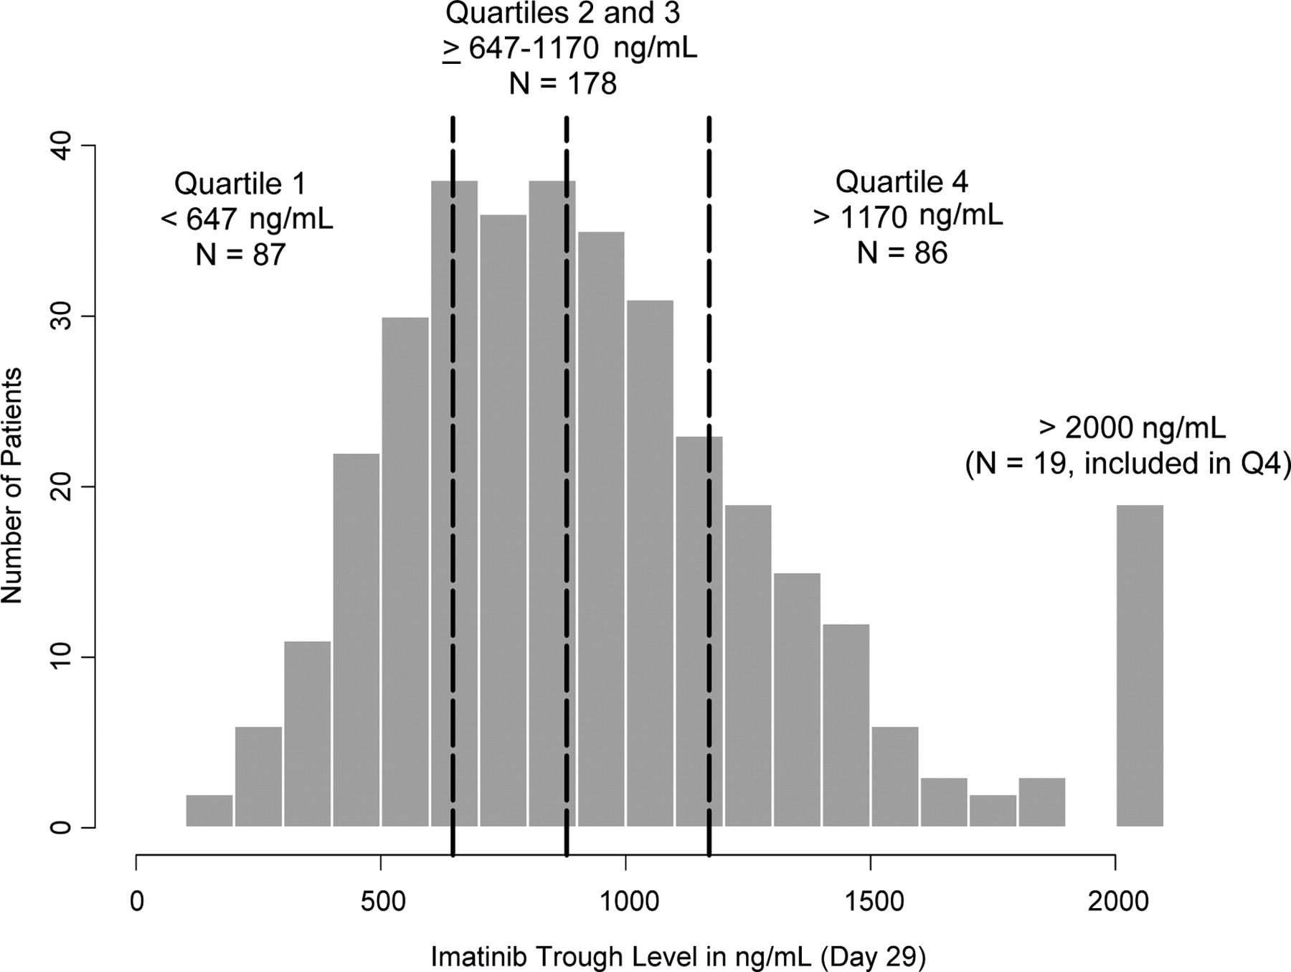
Distribution of imatinib trough levels at 400 mg daily at steady state on day 29 (n = 351).
Richard A. Larson et al. Blood 2008;111:4022-4028
©2008 by American Society of Hematology
Notes:
Distribution of imatinib trough levels at 400 mg daily at steady state on day 29 (n = 351). The vertical dashed lines represent 25th, 50th (median), and 75th percentiles (ie, 647, 879, and 1170 ng/mL, respectively).

Slide 22
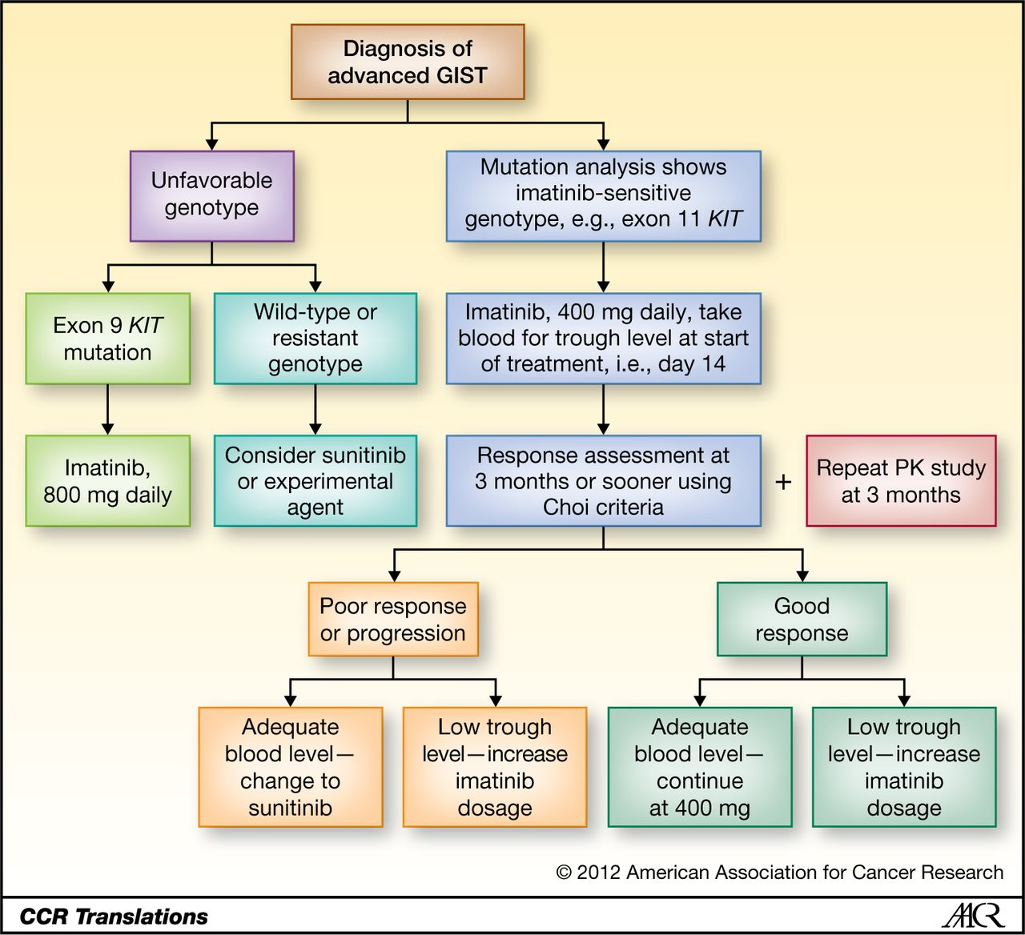

Proposed draft scheme about how therapeutic drug monitoring might work in practice.
30% decrease in
exposure at 3 mo.
cf baseline
(Eechoute et al, CCR, 2012)
Ian Judson Clin Cancer Res 2012;18:5517-5519
©2012 by American Association for Cancer Research
Notes:
Proposed draft scheme about how therapeutic drug monitoring might work in practice. Note that there are many uncertainties, such as the correct treatment of certain unfavorable genotypes, the optimum time for response assessment, and the 3-month trough level associated with poorer outcome, which require further research. PK, pharmacokinetic.

Slide 23
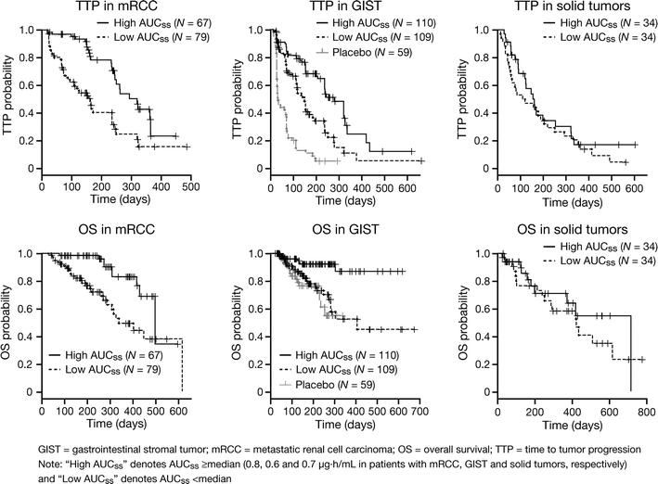
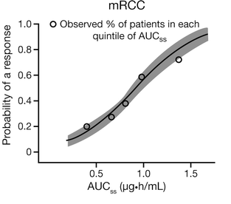
Sunitinib in RCC – similar to Imatinib
Houk BE et al, Ca Chemother Pharmacol, 2010
(high AUC = >median)

Slide 24
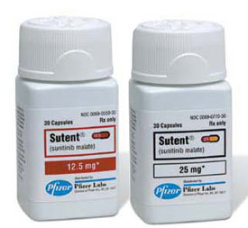
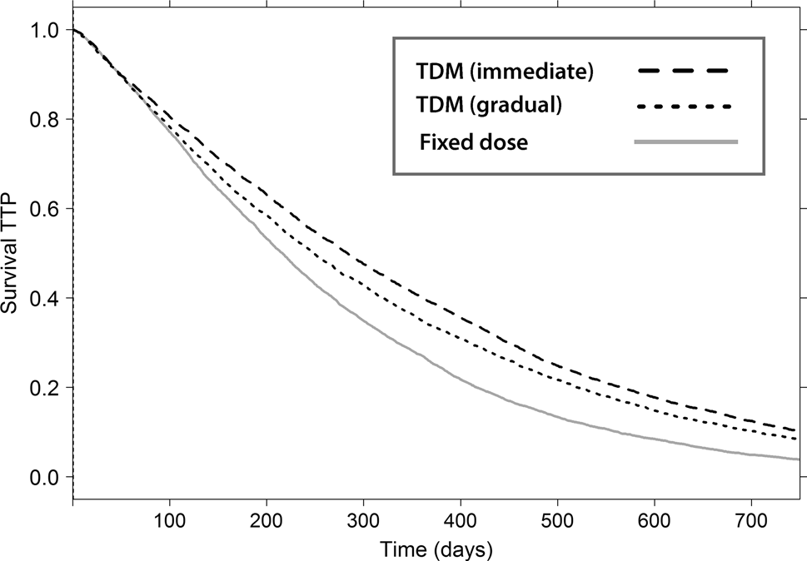
Cancer Chemother Pharmacol (2016) 78:209–216
DOI 10.1007/s00280-016-3071-1
Monte Carlo simulations of the clinical benefits from therapeutic
drug monitoring of sunitinib in patients with gastrointestinal
stromal tumours
Sebastiaan C. Goulooze, Peter Galettis, Alan V. Boddy, Jennifer H. Martin
M-C simulations on published PK/PD model, with adjustment for DLT and dropout rate, etc
TDM might inc. TTP by 1-2 mo. (15-30%)
>1000 pt trial needed to confirm

Slide 25
Some Issues with TDM
precision of blood sampling
  diurnal variation?
  drug stability ex vivo?
blood sample size required, sensitivity
reliability of sparse sampling
remote blood sampling
rapid analysis method
  sample prep
  LC-MS/MS
  immunoassay

Slide 26
Ther Drug Monit. 2016 Dec;38(6):649-656.
Quantification of 11 Therapeutic Kinase Inhibitors in Human Plasma for Therapeutic Drug Monitoring Using Liquid Chromatography Coupled With Tandem Mass Spectrometry.
Herbrink M1, de Vries N, Rosing H, Huitema AD, Nuijen B, Schellens JH, Beijnen JH.
J Chromatogr B Analyt Technol Biomed Life Sci. 2016 Oct 15;1033-1034:17-26. doi: 10.1016/j.jchromb.2016.07.046. Epub 2016 Jul 26.
A novel approach for the simultaneous quantification of 18 small molecule kinase inhibitors in human plasma: A platform for optimised KI dosing.
van Dyk M, Miners JO, Kichenadasse G, McKinnon RA, Rowland A.

Slide 27

Adaptive dosing strategies should achieve clinical benefit

Slide 28
Dose Optimization: Alternatives to TDM
Pharmacogenomics
  not ready for prime time?
  exceptions:
    TPMT and 6MP
    UGT1A1 and irinotecan
Assessment of DME activity (phenotype)
  UH2/Uracil ratio
Test doses

Slide 29
Pharmacogenomics of Fluoropyrimidines

Slide 30
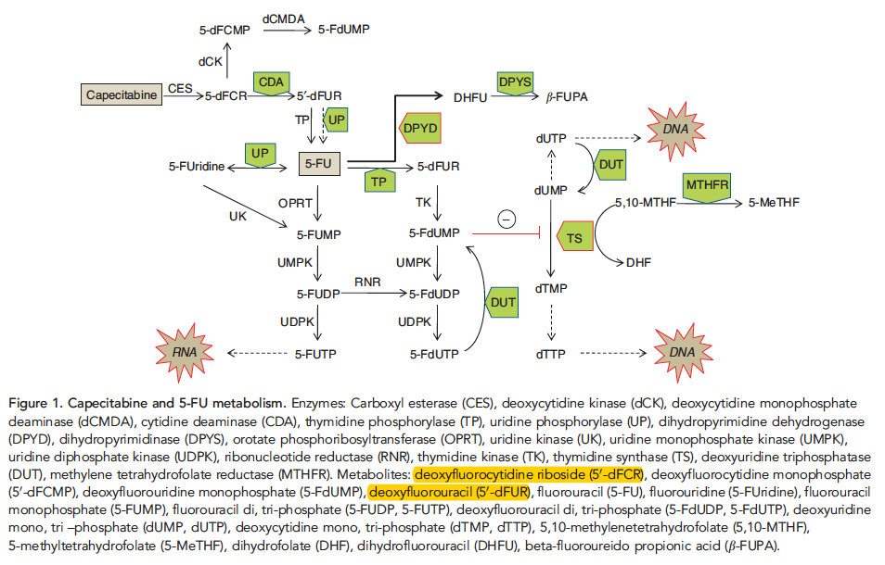
Loganayagam et al BJCa, 2013

Slide 31
Pharmacogenomics of 5FU
DPD
  *2, *5, *6, *9A, *13, 2846A>T, 1236G>A
  heterozygotes 3.9% (3/76 pts)
>50% pts have no known DPD mutation or dec activity
Thymidylate Synthase
  TSER, 3'-UTR (6 bp deletion)

Slide 32
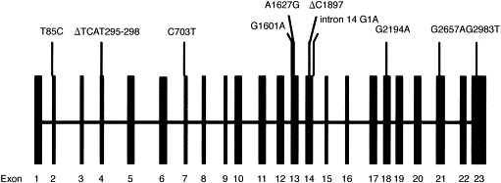
Genetic Polymorphisms in DPYD
1:270, severe deficiency
28%, normal activity
5%, normal activity
from Milano & McLeod, Eur J Cancer 36:37-42, 2000
Notes:
32
However, modern molecular techniques, identifying polymorphisms and common mutations/variants in both normal tissue and malignant cells may be more useful to clinicians. And exploitation of the knowledge about the DPYD gene has been an area of interest in this field. To date, at least 20 polymorphisms of DPYD have been described; many are not known to be associated with altered DPD activity. Also, not all toxicity from 5FU can be explained by DPYD polymorphisms. The most consistent data are for the 14G1A variant, which leads to skipping of exon 14 (allele frequency 1:135), and has led to familial DPD deficiency, which is undetectable normally but can lead to life threatening 5FU toxicity. Even patients that are heterozygote for this polymorphism have low DPD activity and severe toxicity from 5FU. But this poly is rare, and coupled with the number of false positive polys in DPYD, DPD genotype analysis can not yet be substituted for DPD deficiency phenotyping.

Slide 33
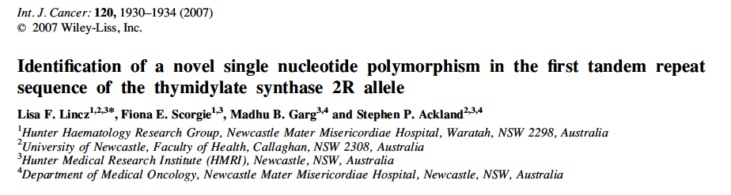
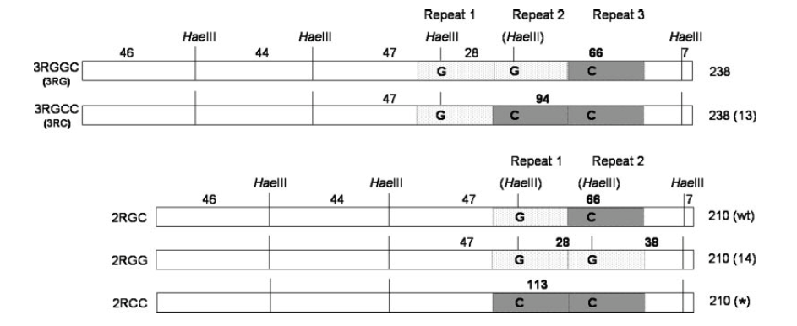
Genetics is complex!!
Notes:
33

Slide 34
PGx not ready for prime time
Hendricks (PGx, 2015)
  gene activity score to individualise 5FU dose
Deenen (JCO, 2011)
  22/2038 pts het for DPD*2A
  dose reduced 50% in C1
  G3-4 toxicity 28% (vs 73% historical controls)
  cost savings $61 per pt.

Slide 35
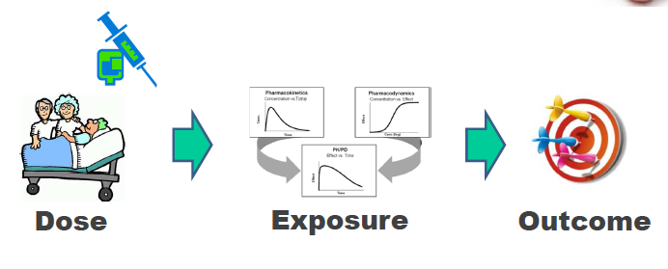

Slide 36
Conclusions:
Dose Individualisation via Drug Measurement
1. TDM can improve delivery of established drugs
2. TDM is now clearly feasible for many drugs
3. Phase I trials should include adequate PK
4. Phase II trials should include drug PK
5. Phase III trials should include pop PK sampling
6. TDM studies should be considered in post-marketing

