Slide 1
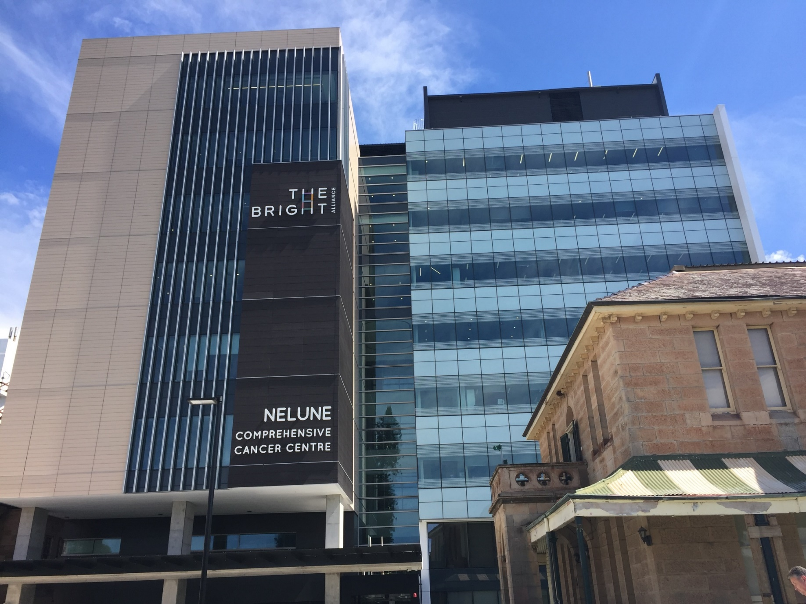
SCR
Dr Charlotte Lemech
Medical Director, Scientia Clinical Research

Slide 2
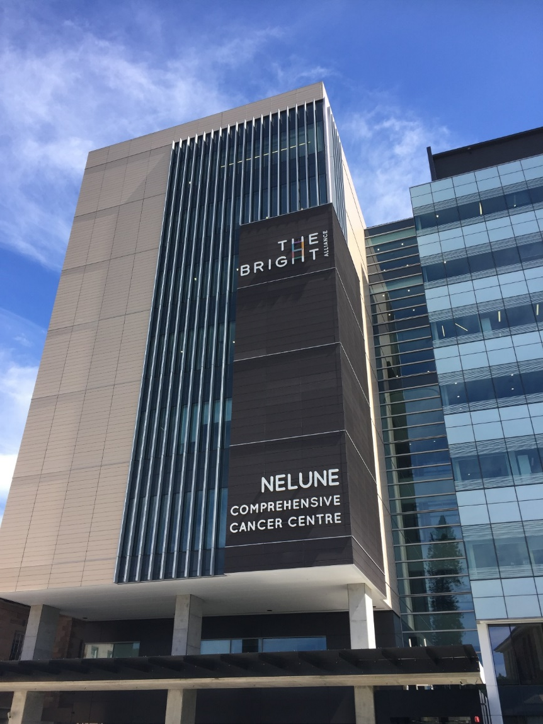
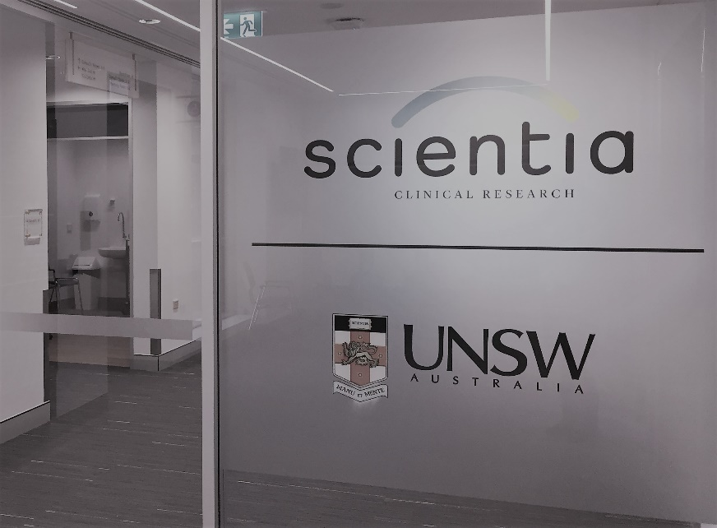
Overview
The first purpose built, publicly funded early phase clinical trials facility in NSW
Controlled entity owned by UNSW and funded by UNSW, NSW and commonwealth government
Located within the Bright Alliance Building with the Nelune Comprehensive Cancer Centre and the Sydney Children’s Hospital
Notes:
The Bright Alliance aims to accelerate world class research in cancer prevention, treatment and care and provide access for more patients to this research

Slide 3
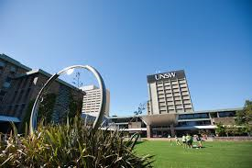
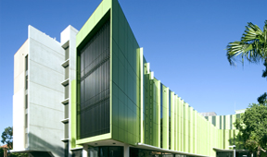
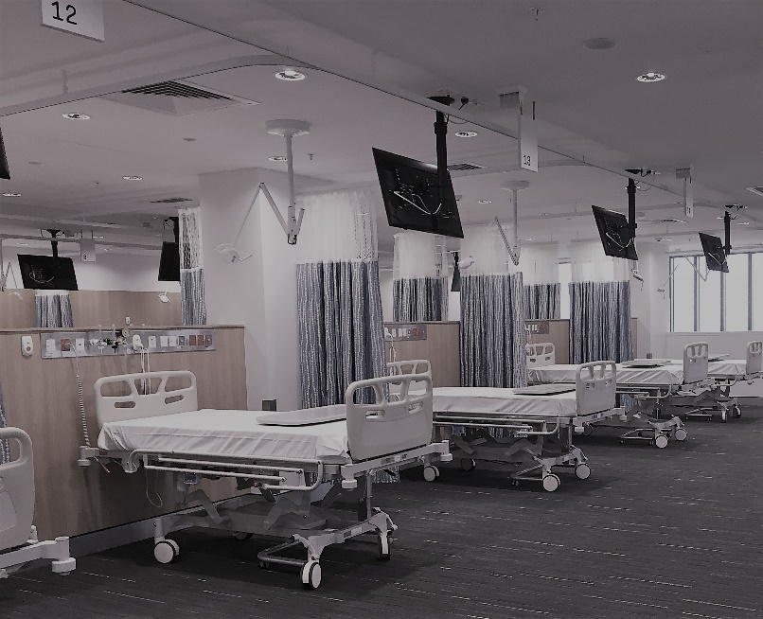
Co-located in a major research precinct with Prince of Wales Hospital, Royal Hospital for Women, Sydney Children’s Hospital, UNSW and the Lowy Cancer Research Centre
Creating a research hub to:
Provide more opportunities for patients to be
included in clinical trials
Enhance the skills and knowledge of clinical
researchers and ancillary staff
Create career opportunities for staff wanting
to specialise in clinical research
Establish a support network for researchers
to increase trial activity and share ideas

Slide 4
The SCR Team
Lisa Nelson, CEO
Extensive phase I and clinical trial operational expertise, both local and international including the established phase I centres, Nucleus Network in Melbourne and Linear in Perth.
Charlotte Lemech, Medical Director
Medical Oncologist and investigator in over 30 oncology and haematology studies including first-in-patient studies in the UK and Australia.
Franziska Loehrer, Quality Systems Manager
Extensive phase I experience, including as General Manager of the phase I GSK unit previously located at Prince of Wales Hospital, Sydney
Justin Nash, Lab Manager
PhD (Organic Chemistry) with a particular interest in PD markers, Nuclear Magnetic Resonance, Liquid Chromatography-Mass Spectrometry and quantitation of peptides and small molecules.

Slide 5
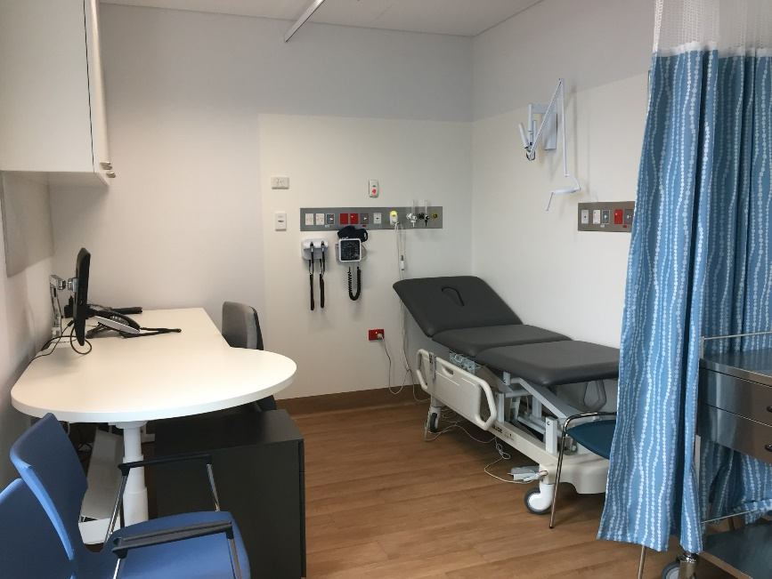
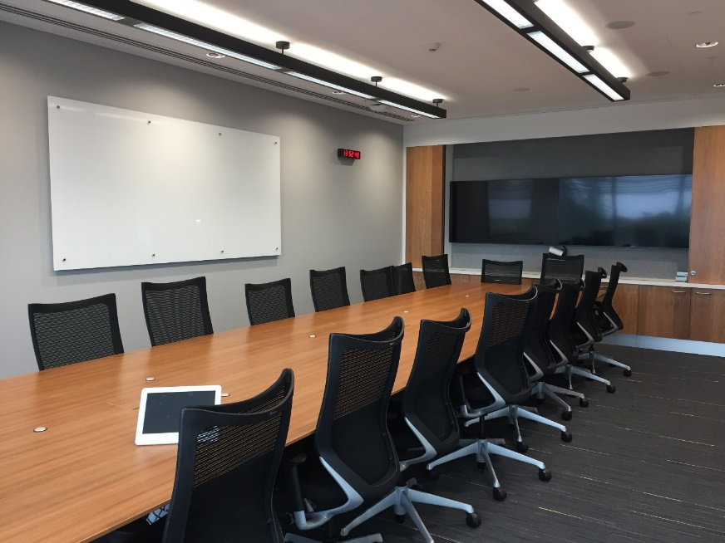
The Facility
First-in-human, first-in-patient clinical trials in patient groups and healthy volunteers
Ability to perform and support later phase trials in patient groups across therapeutic disciplines
Level 5
17 consult rooms
2 procedure rooms
Board room and offices
IP dispensing suite

Slide 6
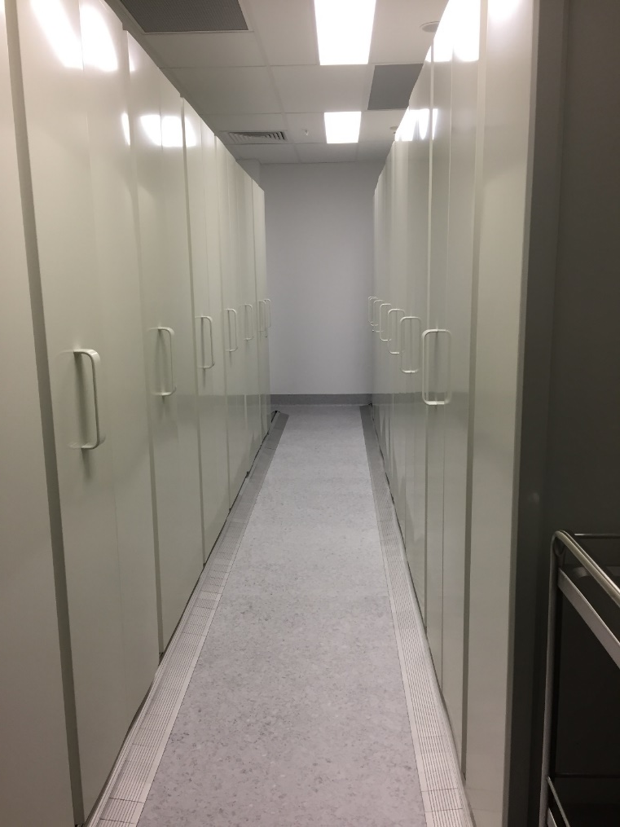

Slide 7
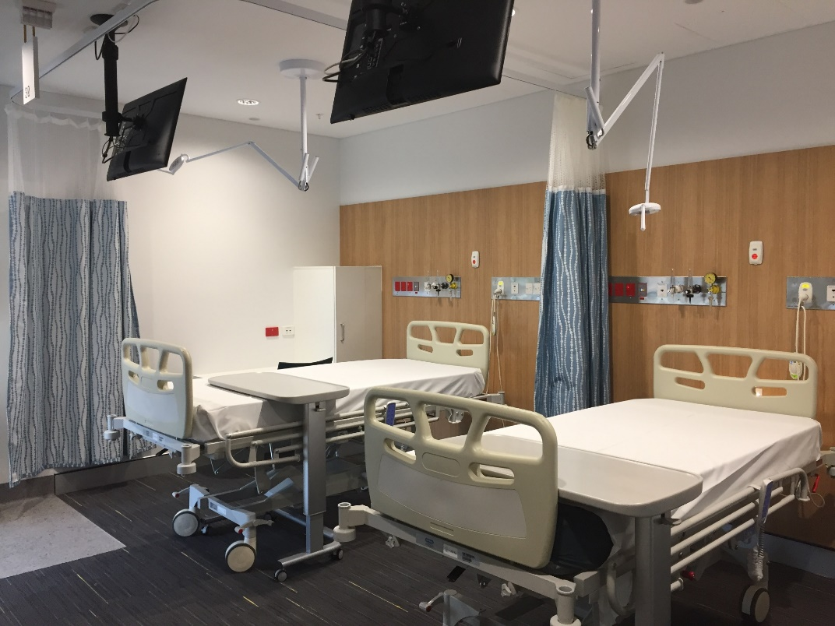
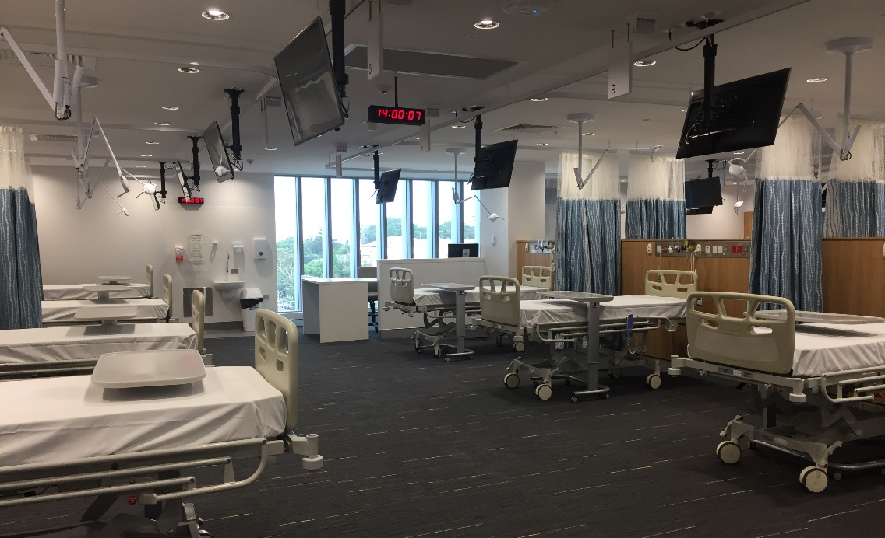
Level 6
30 inpatient beds
2- and 4- bed private rooms
24-bed open ward
Laboratory and freezer room
IP suite
Ambulatory telemetry, blood pressure and holter monitoring, spirometry

Slide 8
Pharmacy services
Temperature monitored IP storage area
Grade B manufacturing suite
Laboratory capabilities
Receipt, distribution of samples
Freezer room
LCMS assay development and processing
Biomarker development

Slide 9
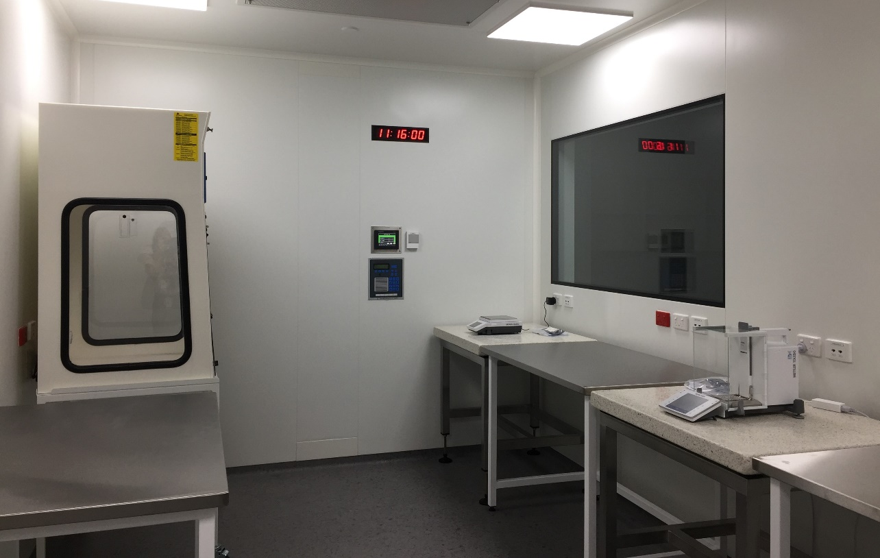

Slide 10
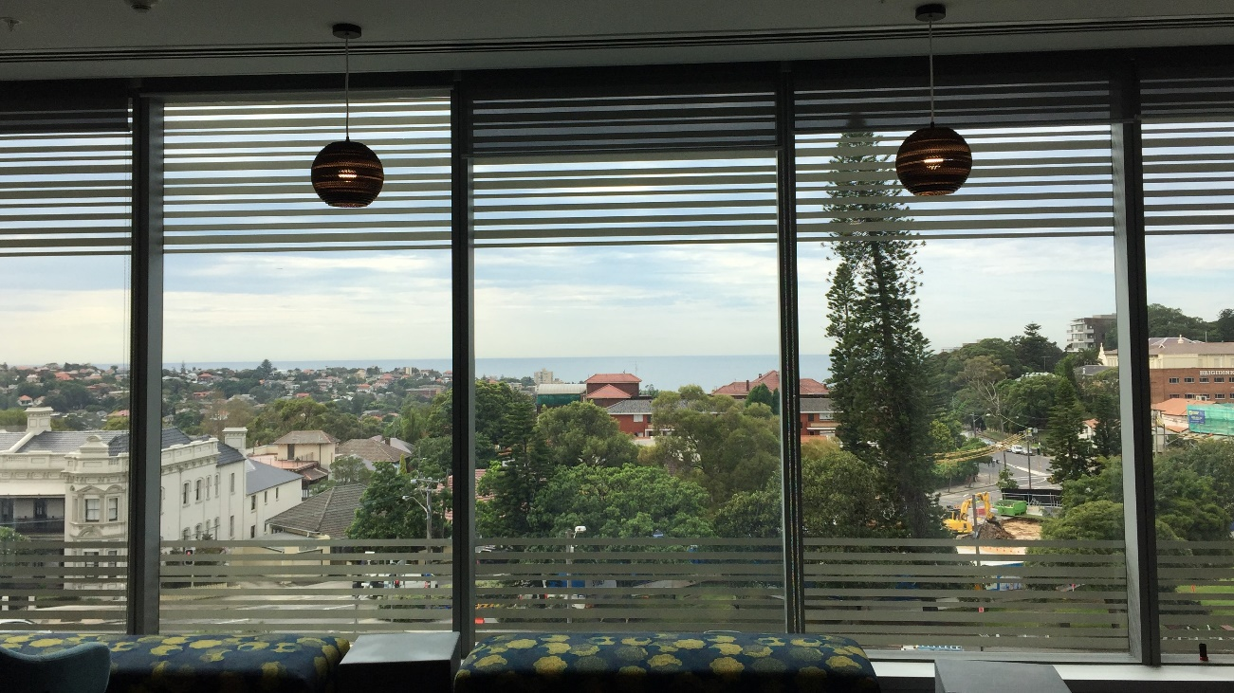
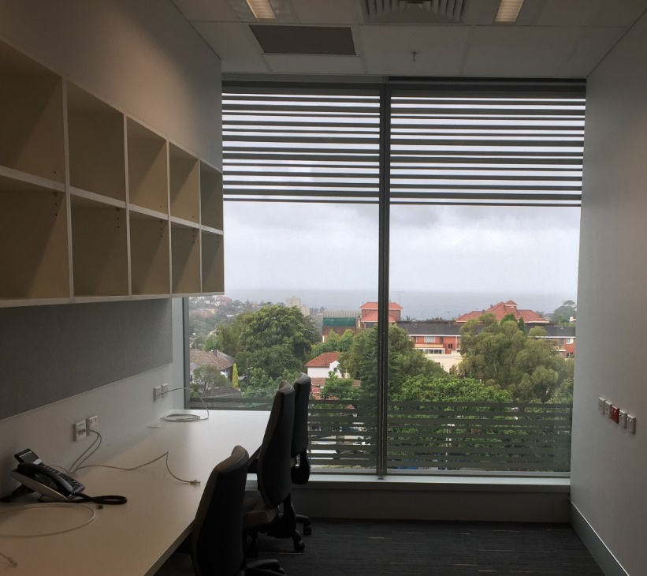
What makes Scientia?
The View!

Slide 11
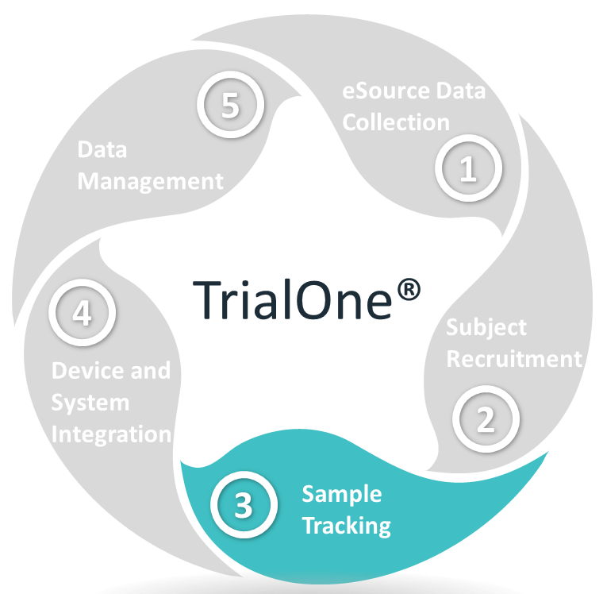
Trial One
Automates clinic operations to manage recruitment, data management and sample tracking
Real-time study data collection to reduce errors and improve timelines
Integrates with bedside patient monitoring, telemetry, ECGs
Supports open-label, single and double blinding
Generates schedules and provides appointment reminder notifications
Allows remote monitoring
Tablet-compatible

Slide 12
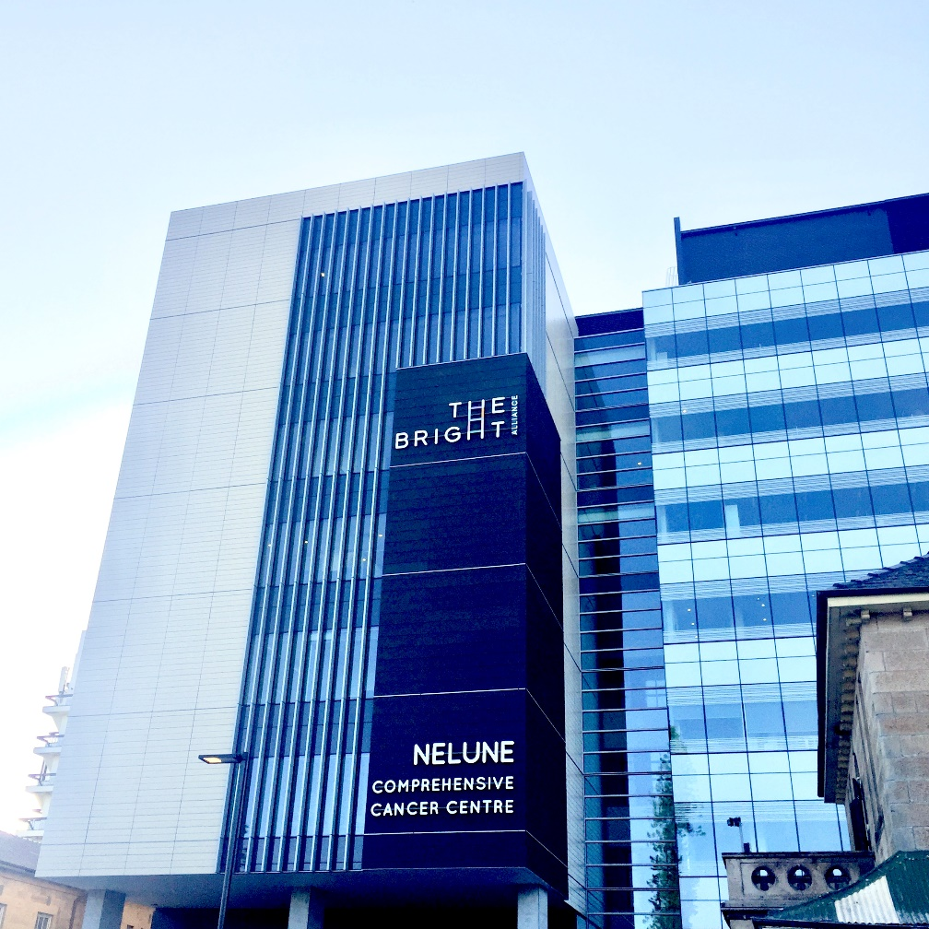
The People
at SCR, POWH and UNSW
The Collaborations
The Bright Alliance
NECTA
Australian sites
International

